Slide 1
Calculus of Variations Approach to Social Distancing

Slide 2
## Loading required package: ggplot2
## Loading required package: viridis
## Loading required package: viridisLite
## Loading required package: ggthemes
## Loading required package: rootSolve
## Loading required package: latex2exp
## ## Attaching package: 'dplyr'
## The following objects are masked from 'package:stats': ## ## filter, lag
## The following objects are masked from 'package:base': ## ## intersect, setdiff, setequal, union
## Loading required package: spam
## Loading required package: dotCall64
## Loading required package: grid
## Spam version 2.7-0 (2021-06-25) is loaded. ## Type 'help( Spam)' or 'demo( spam)' for a short introduction ## and overview of this package. ## Help for individual functions is also obtained by adding the ## suffix '.spam' to the function name, e.g. 'help( chol.spam)'.
## ## Attaching package: 'spam'
## The following objects are masked from 'package:base': ## ## backsolve, forwardsolve
## See https://github.com/NCAR/Fields for ## an extensive vignette, other supplements and source code
## Loading required package: tidyr
## ## Attaching package: 'tidyr'
## The following object is masked from 'package:reshape2': ## ## smiths

Slide 3
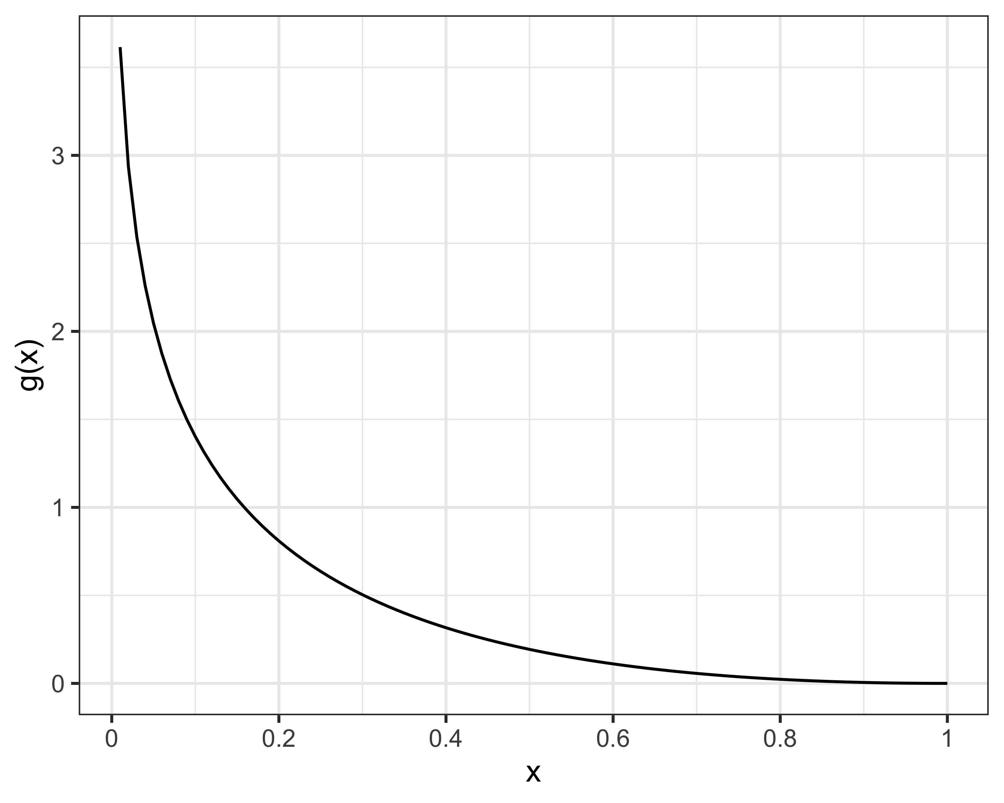

Slide 4
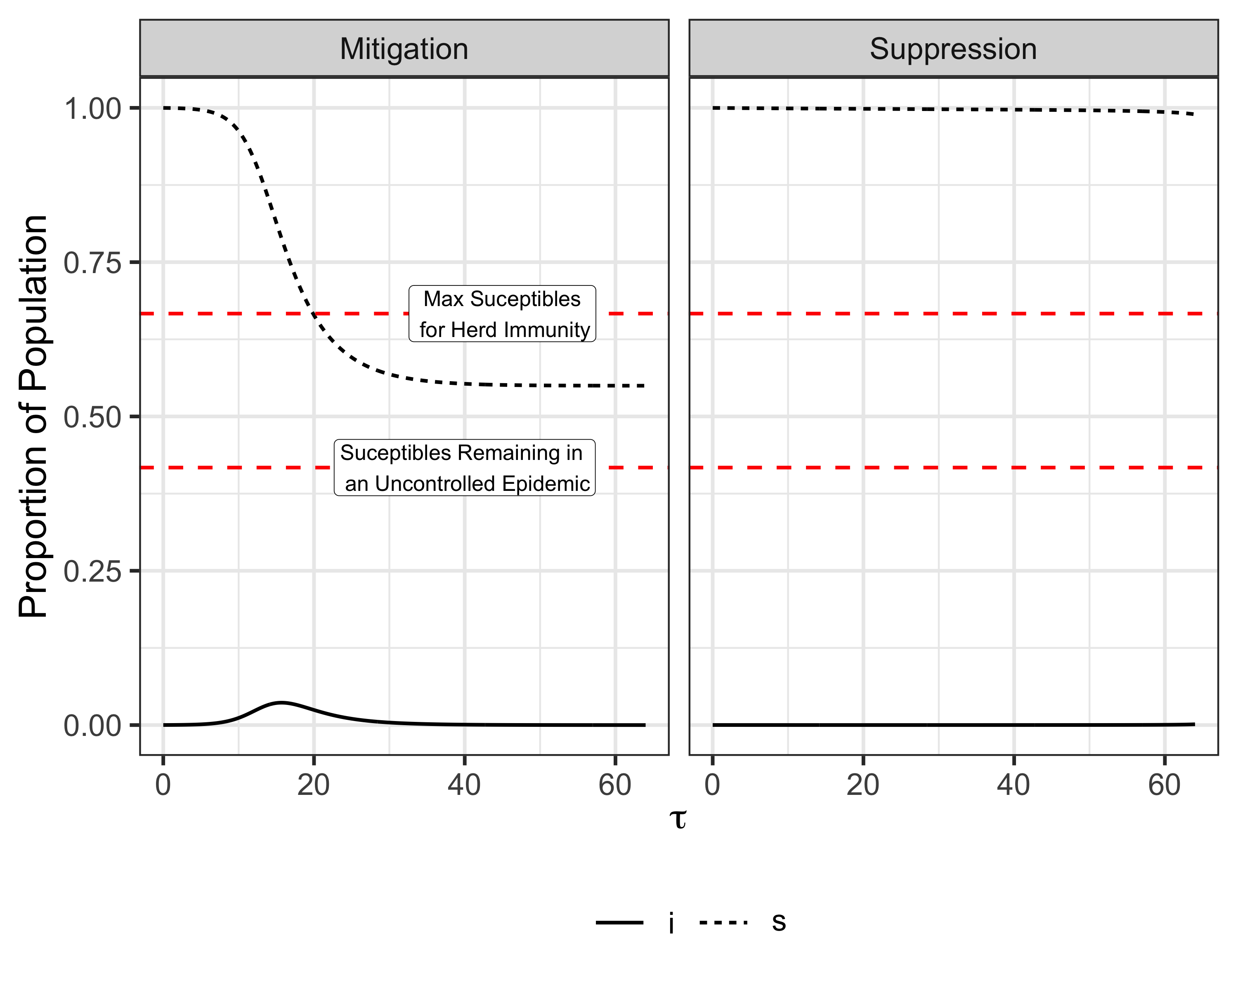

Slide 5
## quartz_off_screen ## 2

Slide 6
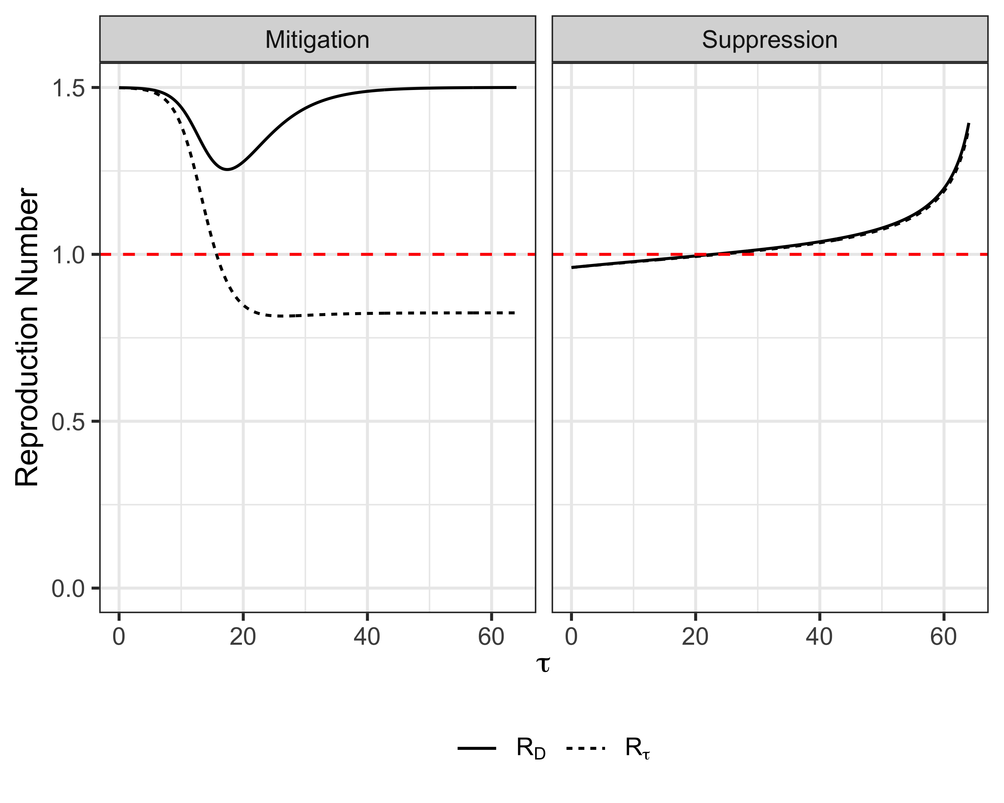

Slide 7
## quartz_off_screen ## 2

Slide 8
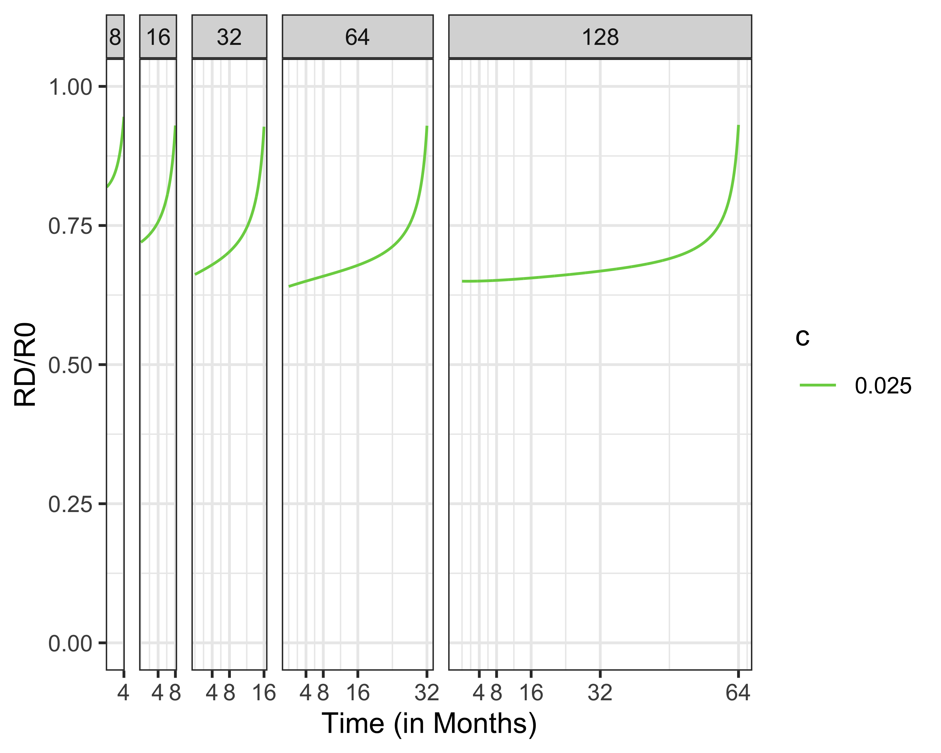

Slide 9
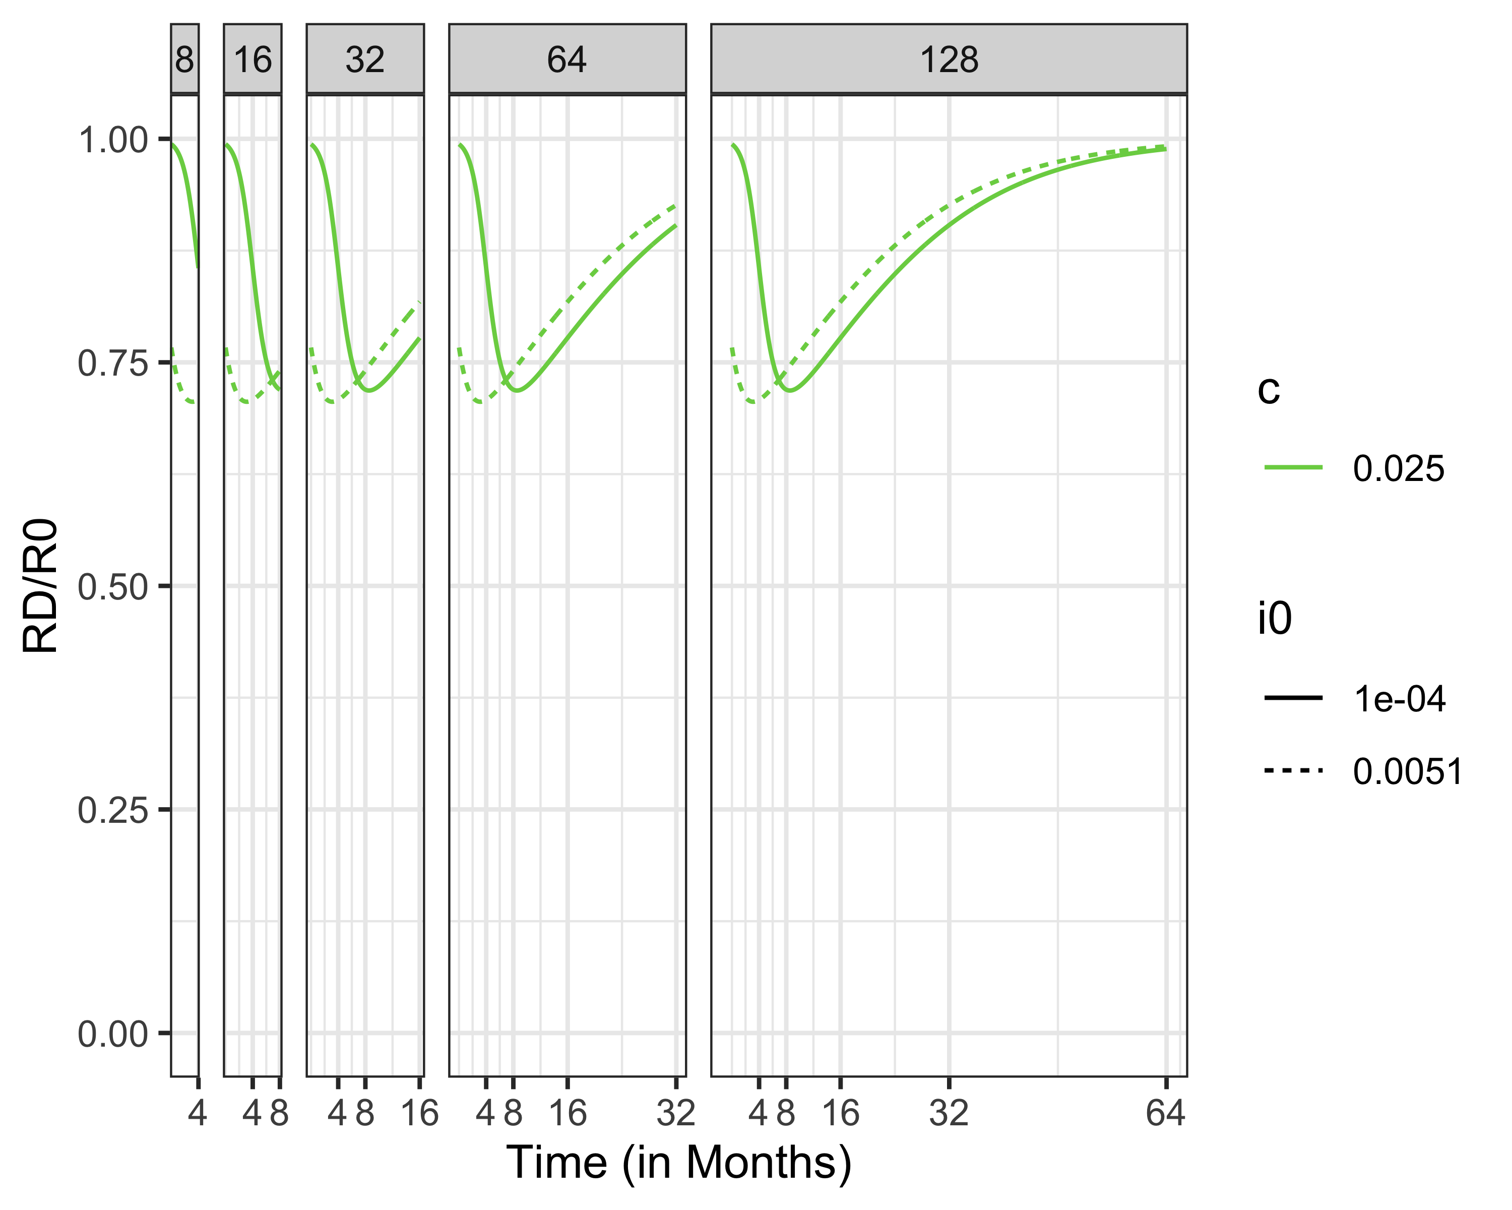

Slide 10
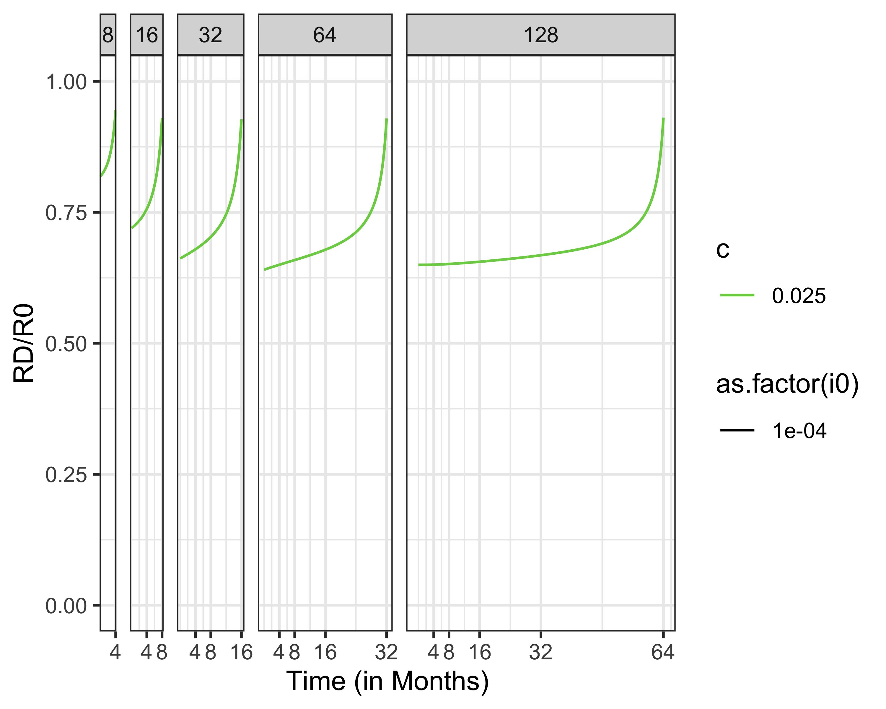
R_D/R_0, Social Distancing Over Time

Slide 11
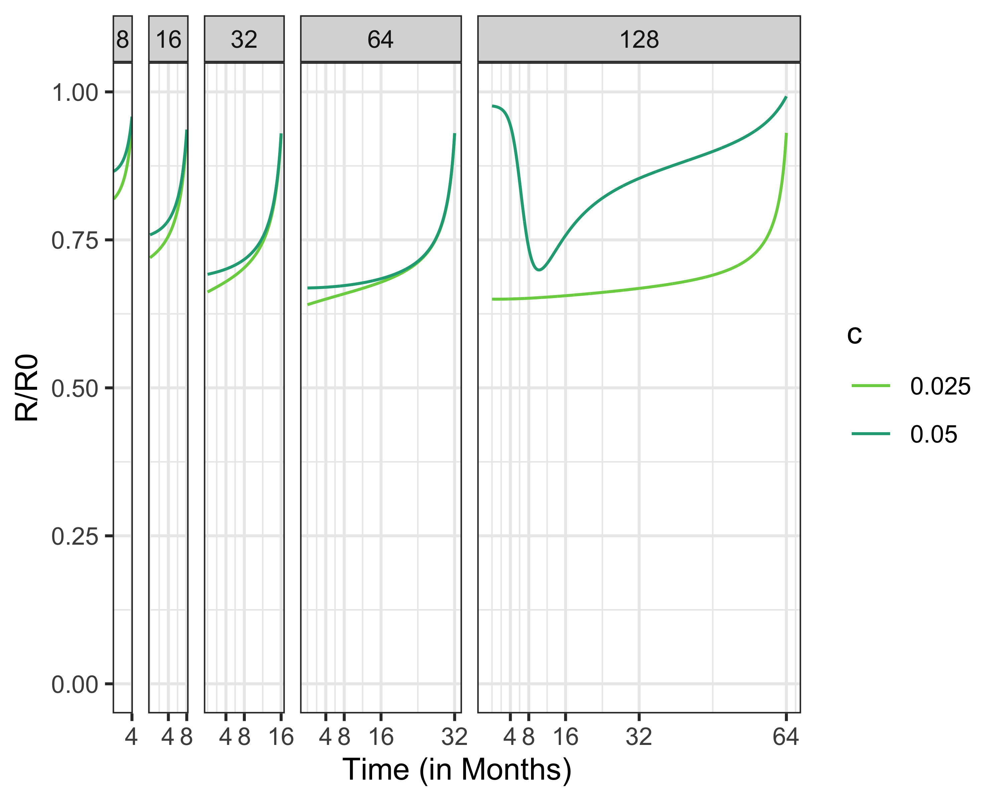

Slide 12
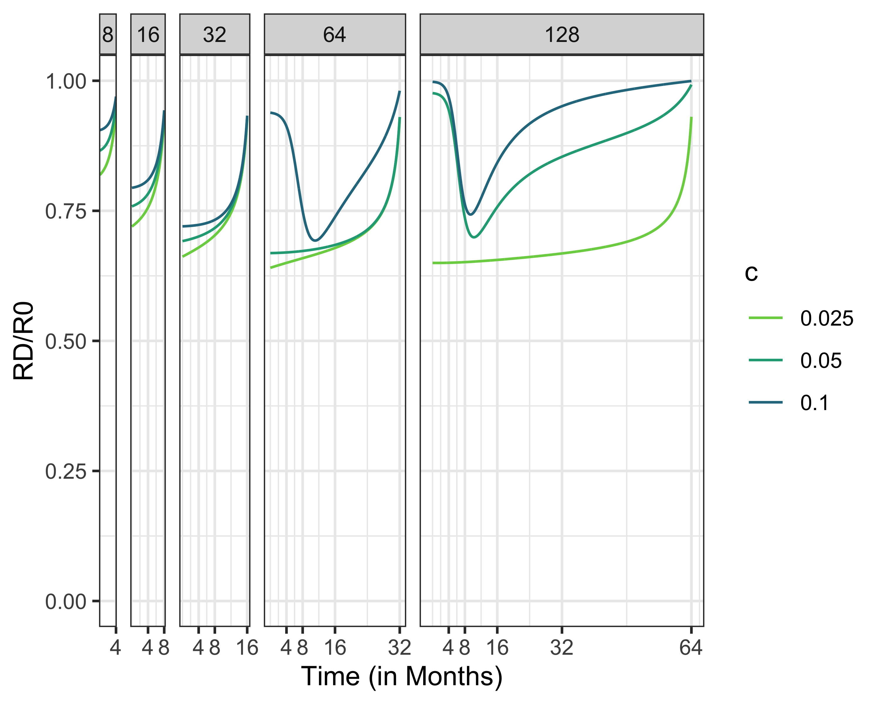

Slide 13
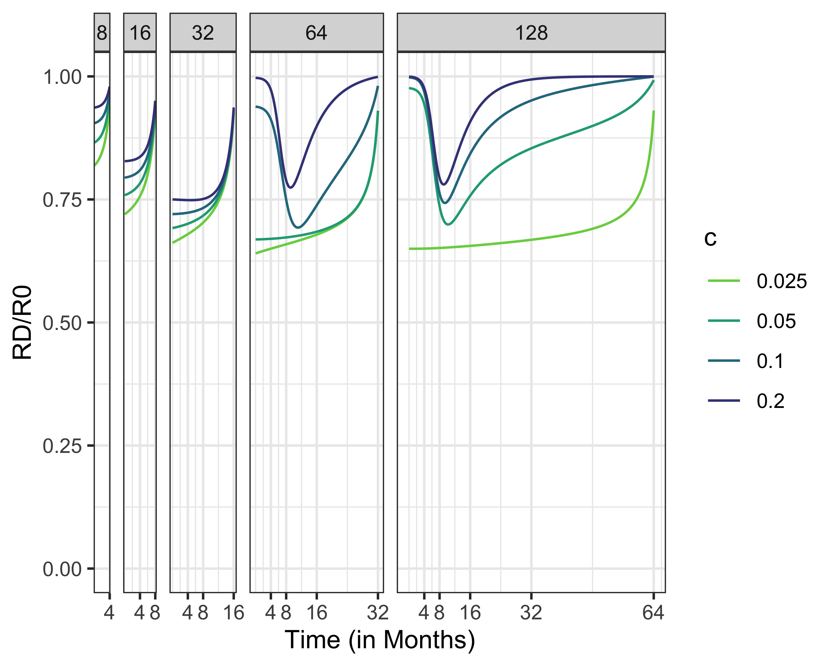

Slide 14
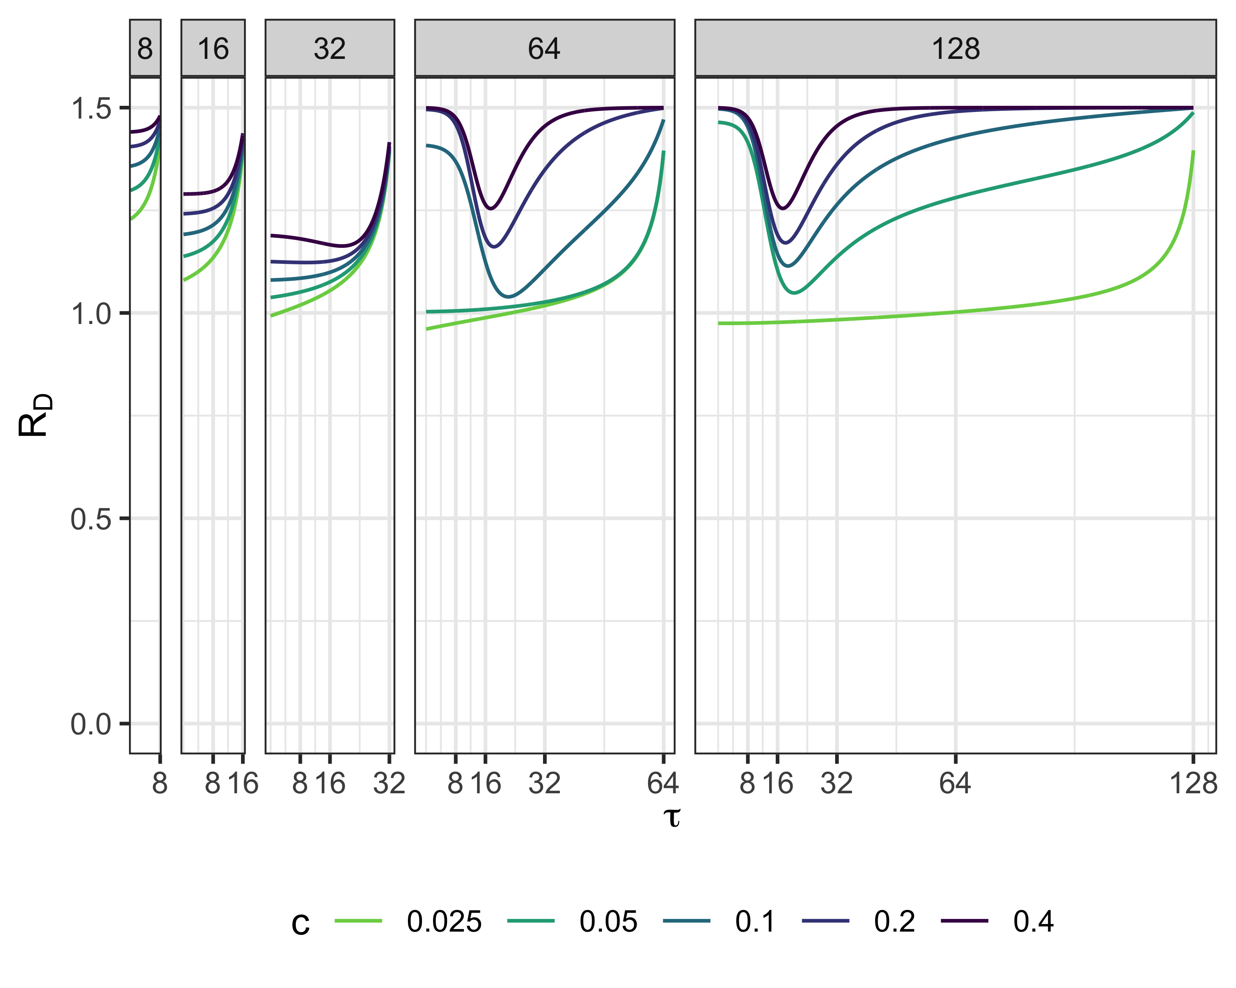
RD, R0 = 1.5

Slide 15
## quartz_off_screen ## 2

Slide 16
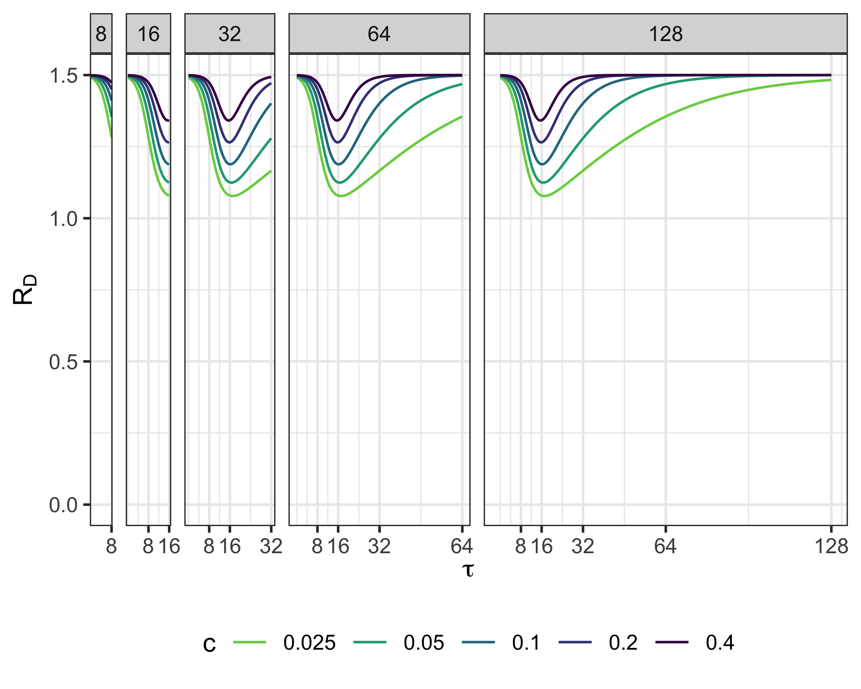

Slide 17
## quartz_off_screen ## 2

Slide 18
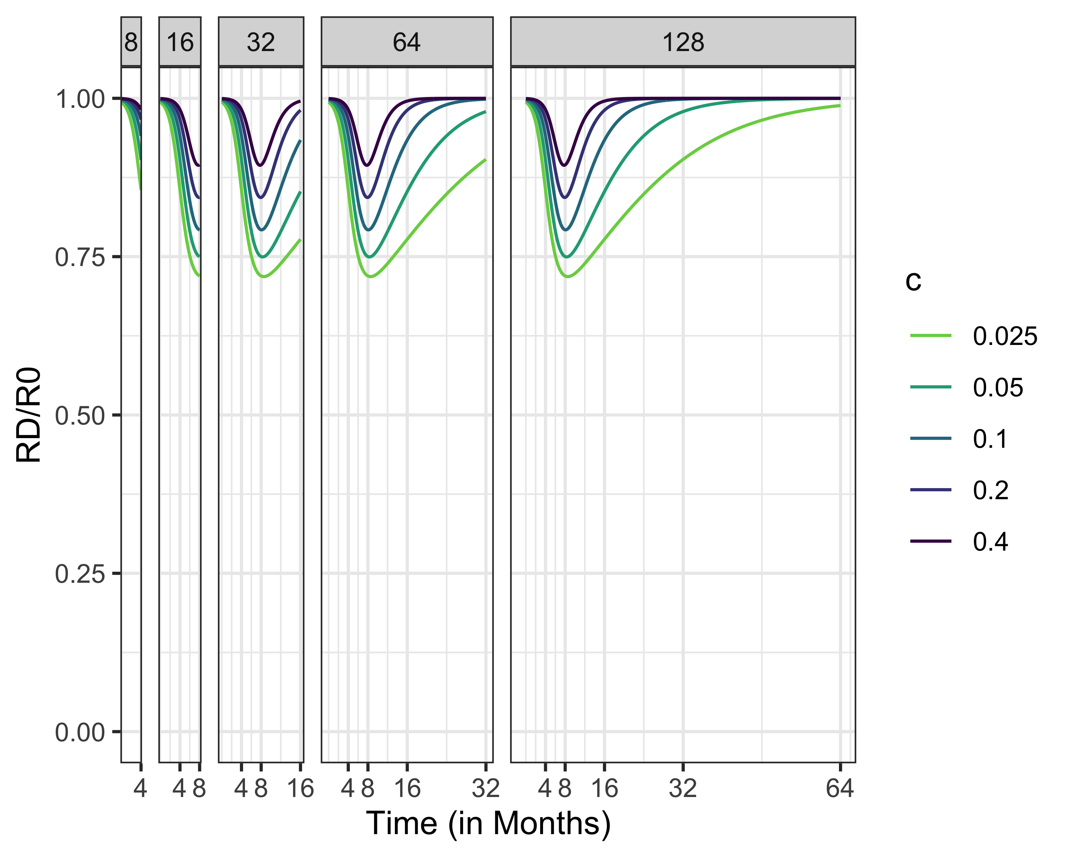

Slide 19
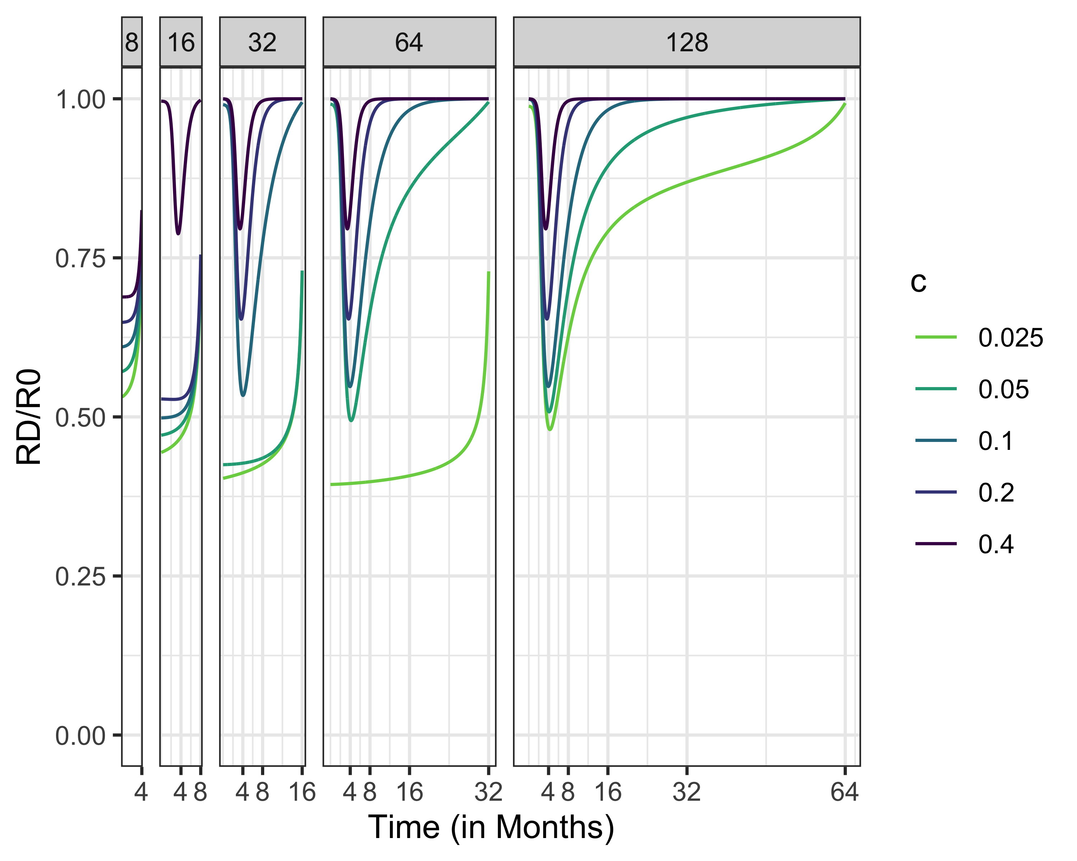

Slide 20
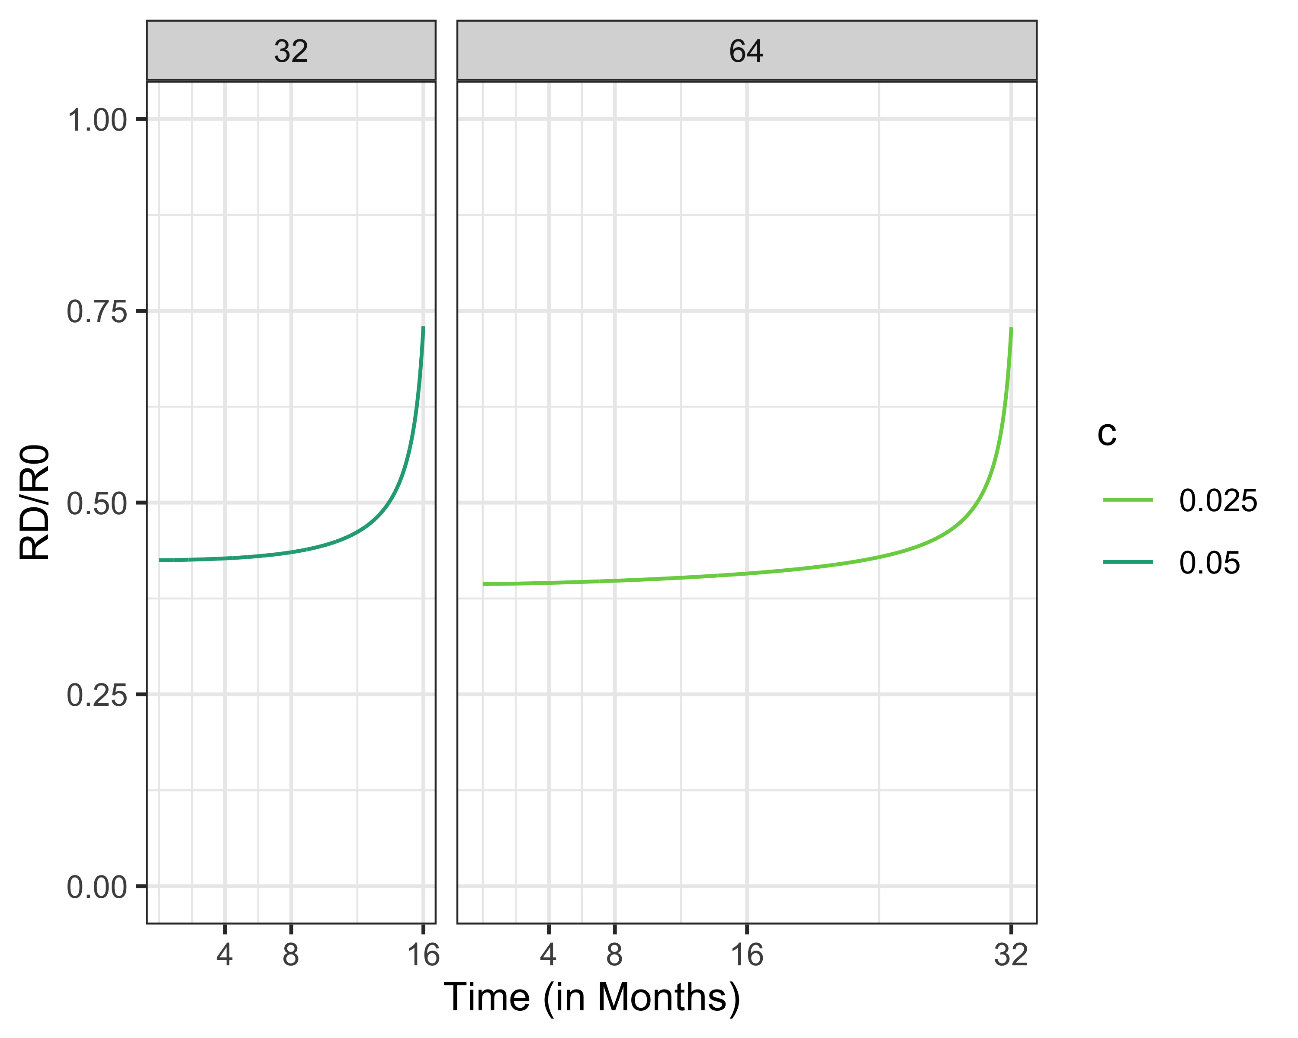

Slide 21
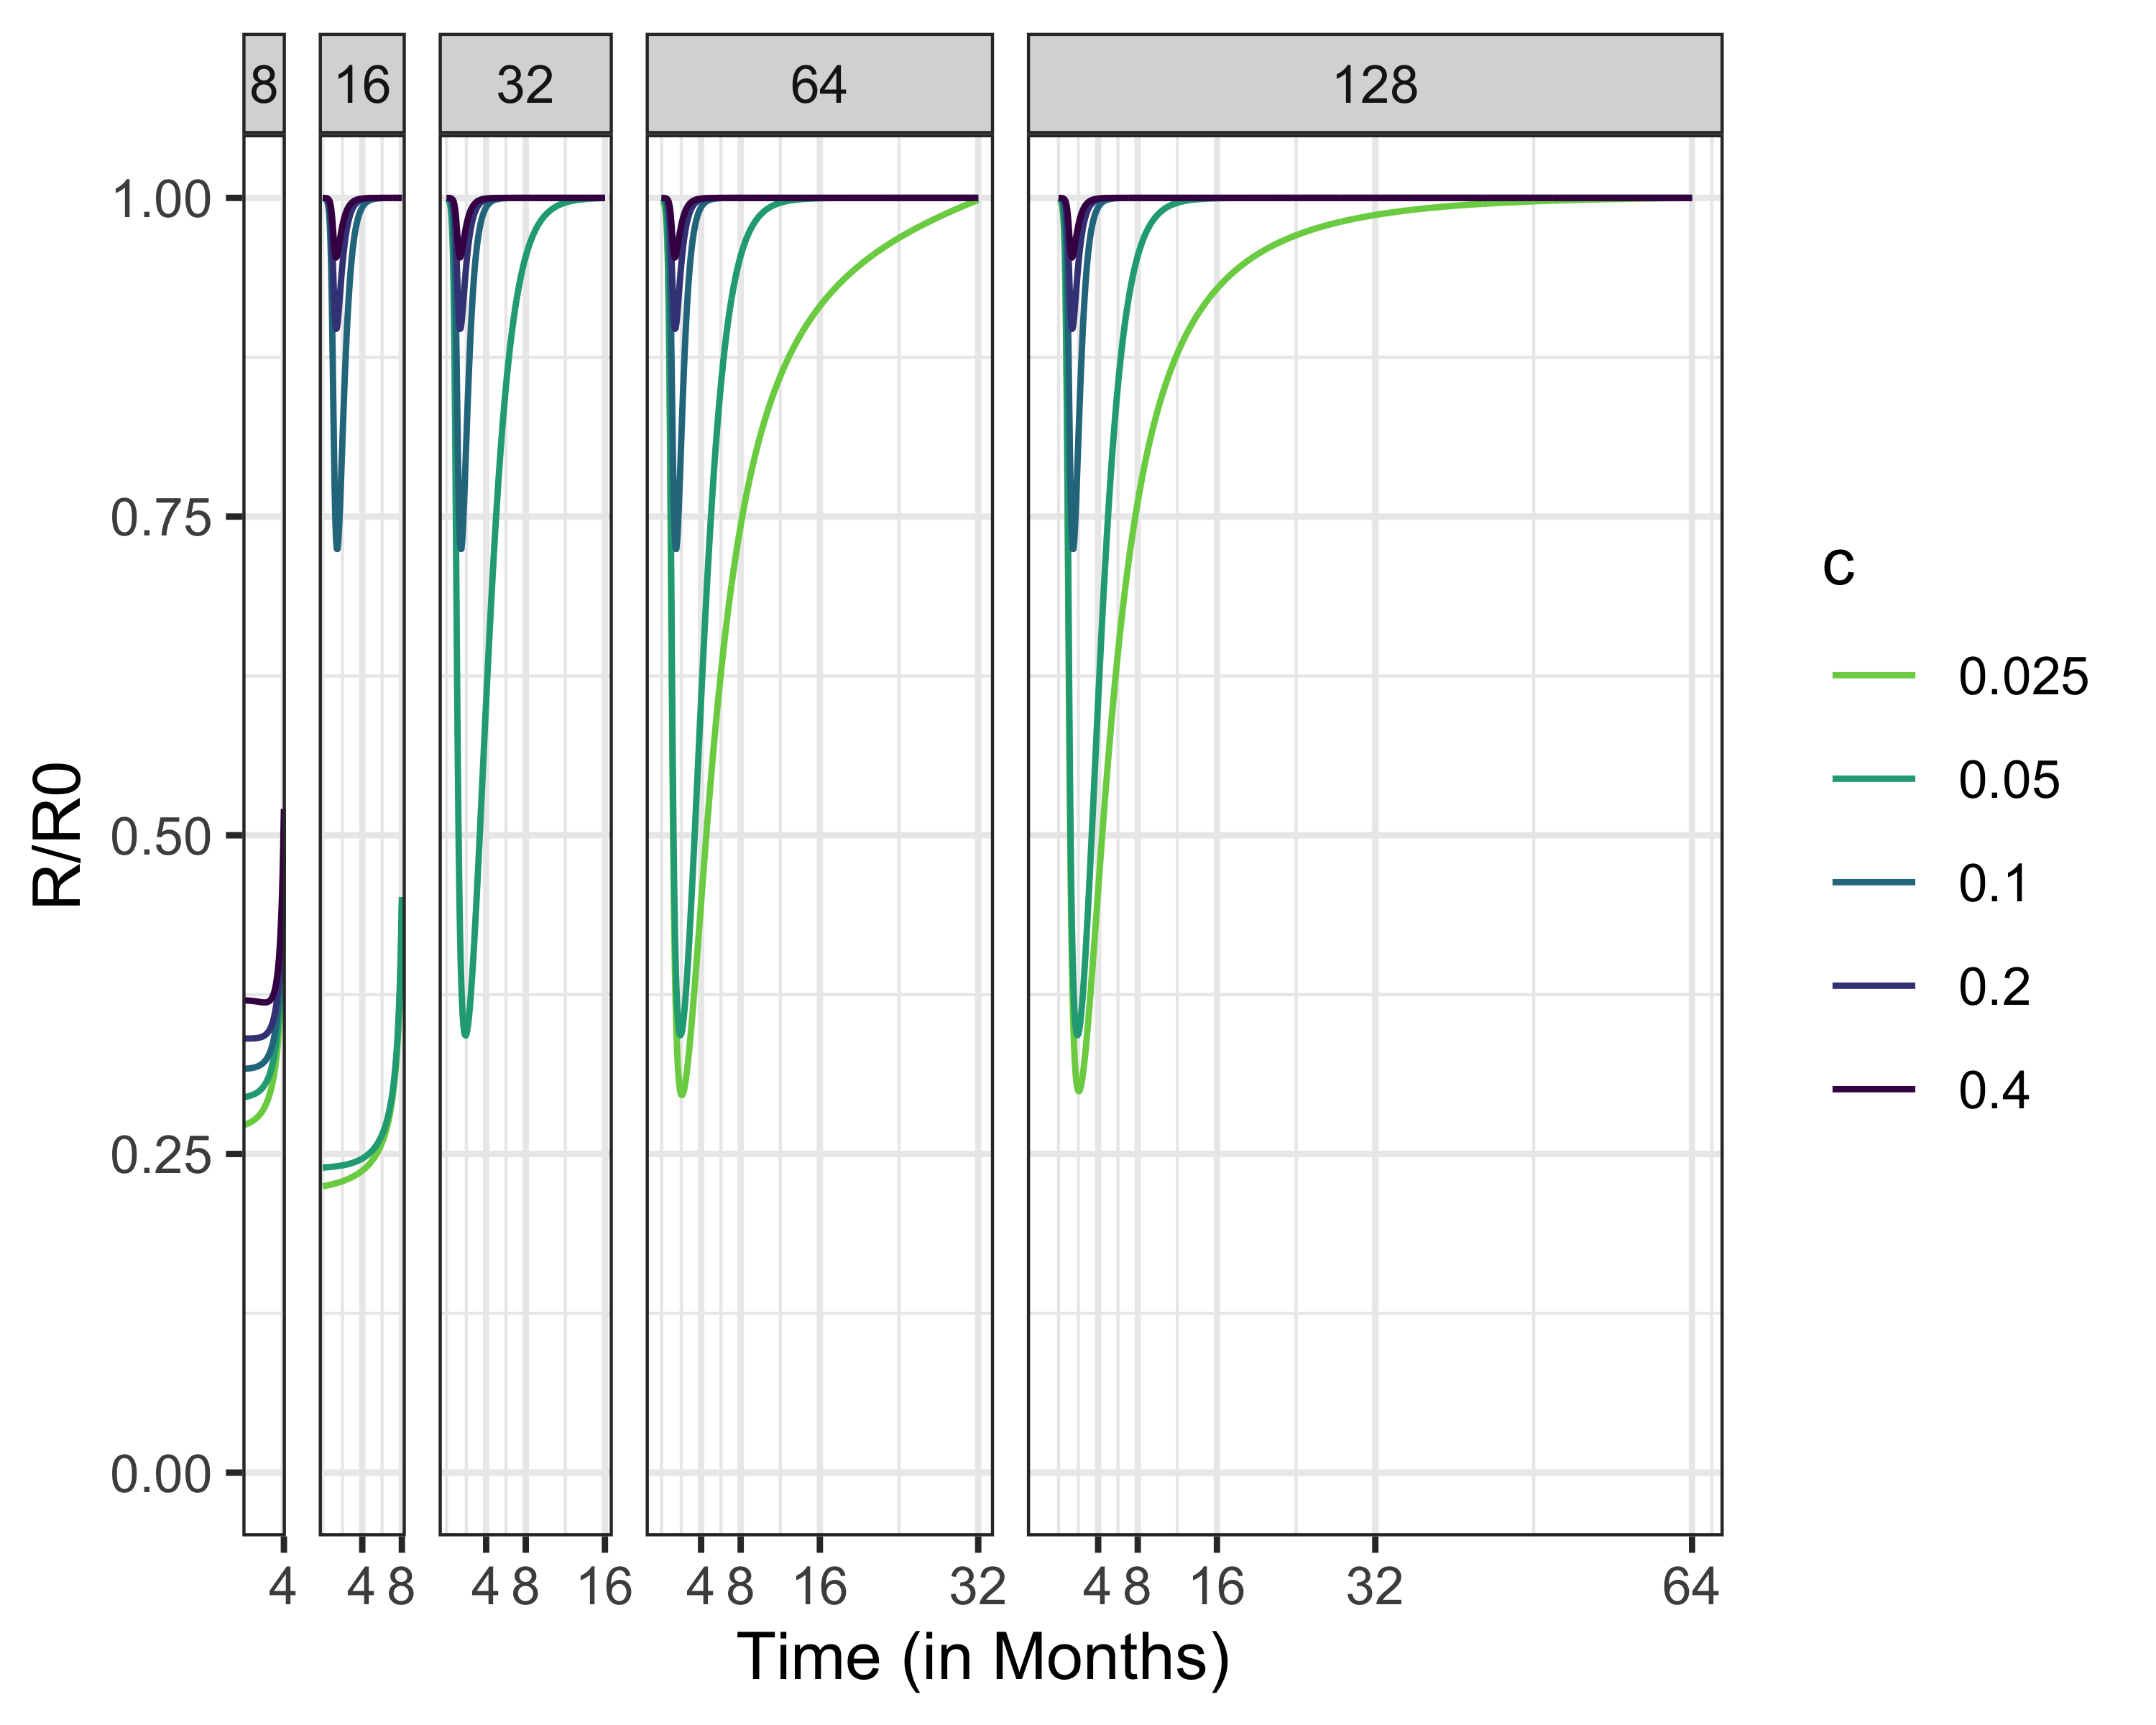
RD, R0 = 5

Slide 22
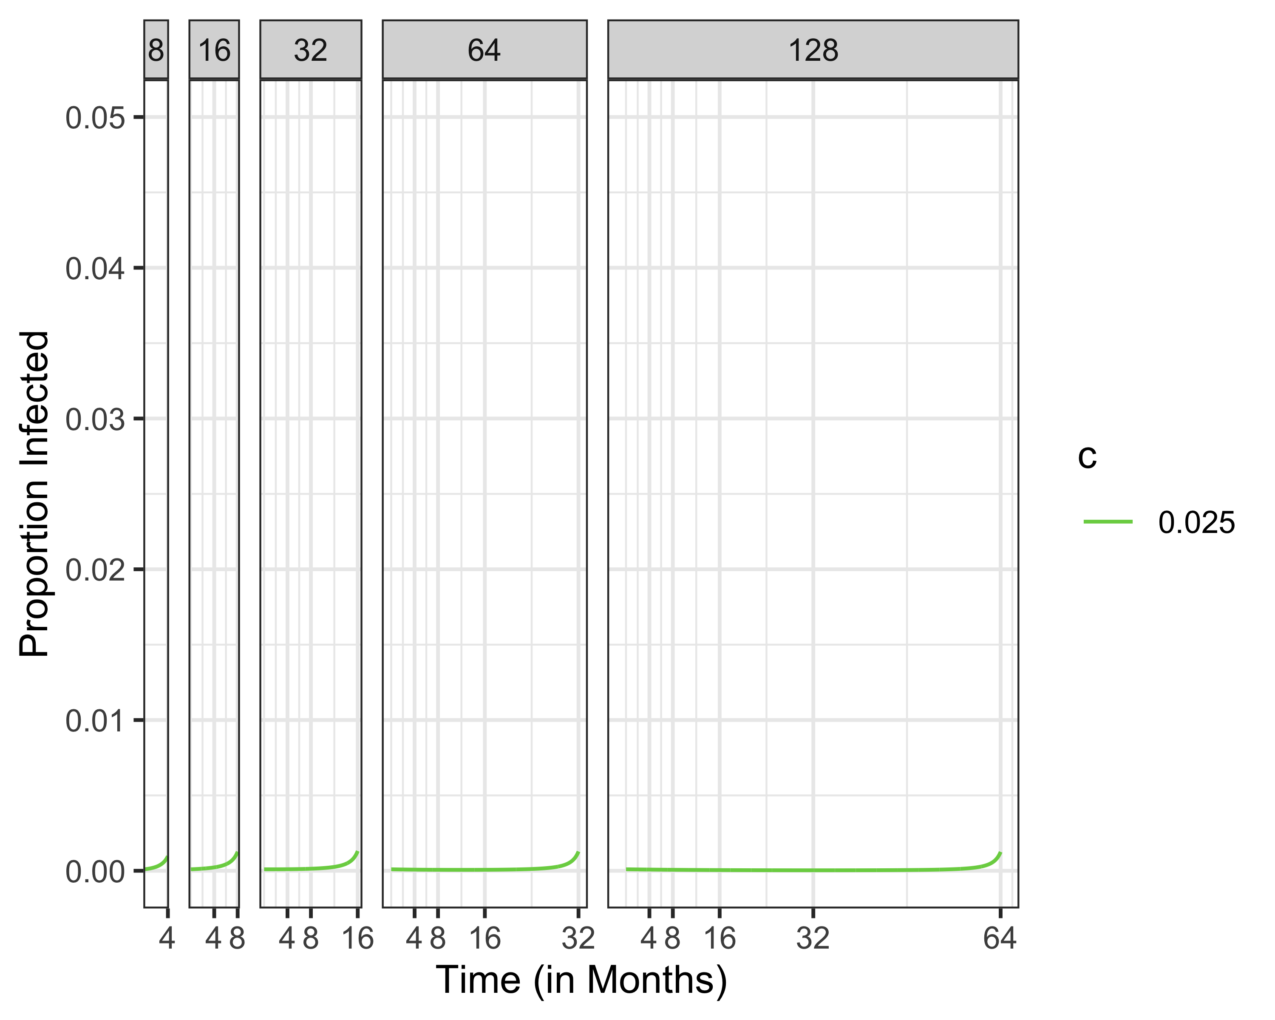
Infected, R0 = 1.5

Slide 23
# Infected, R0 = 1.5

Slide 24
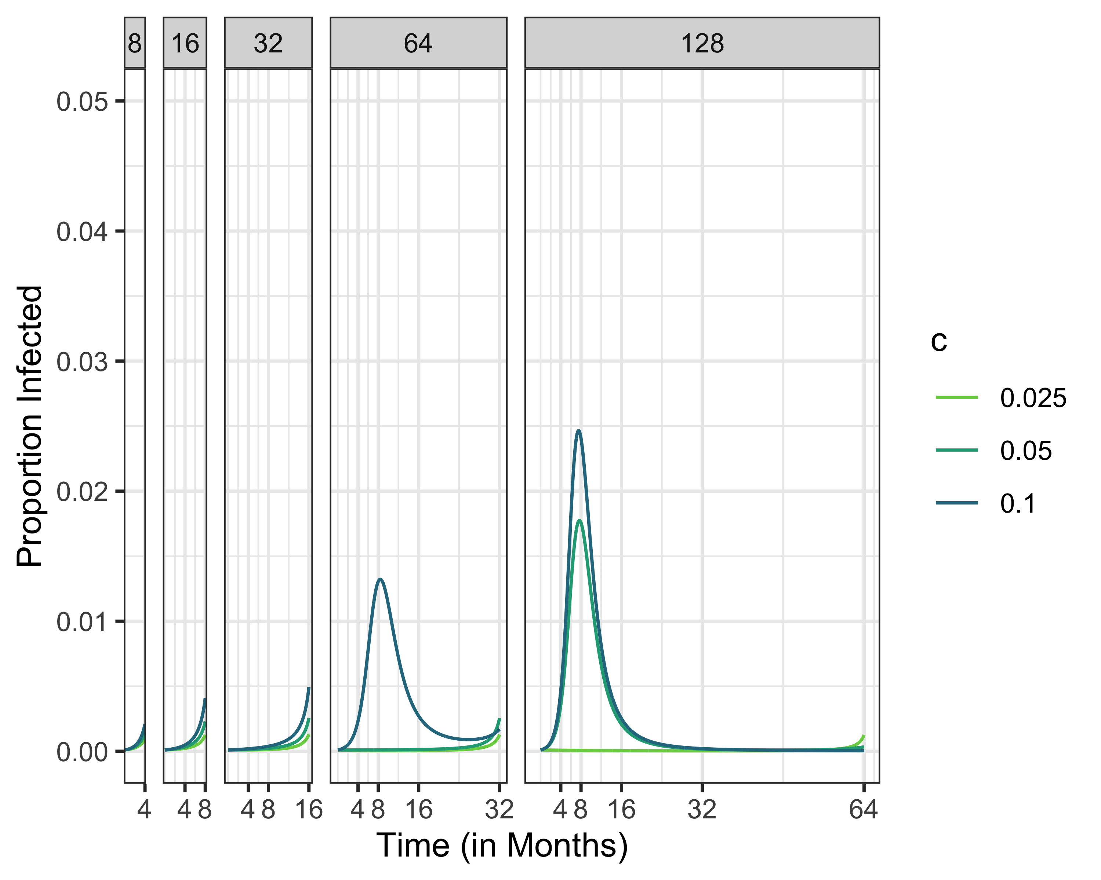
Infected, R0 = 1.5

Slide 25
# Infected, R0 = 1.5

Slide 26
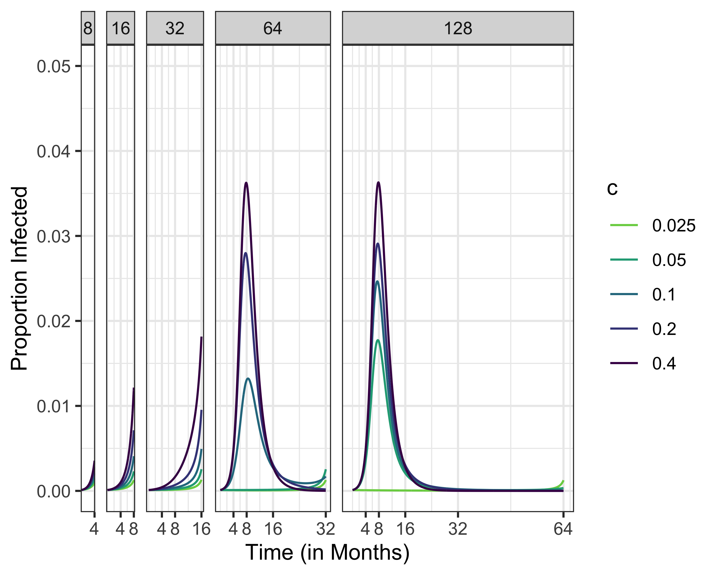
Infected, R0 = 1.5

Slide 27
# Infected, R0 = 2.5 # Infected, R0 = 5
## Warning: Removed 75 row(s) containing missing values (geom_path).

Slide 28
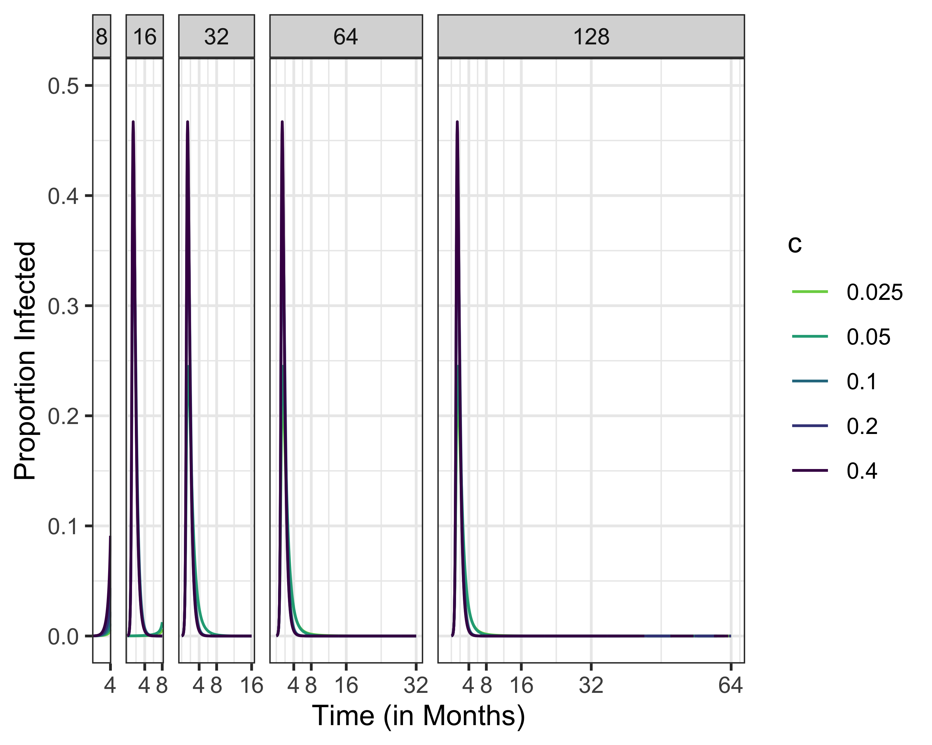

Slide 29
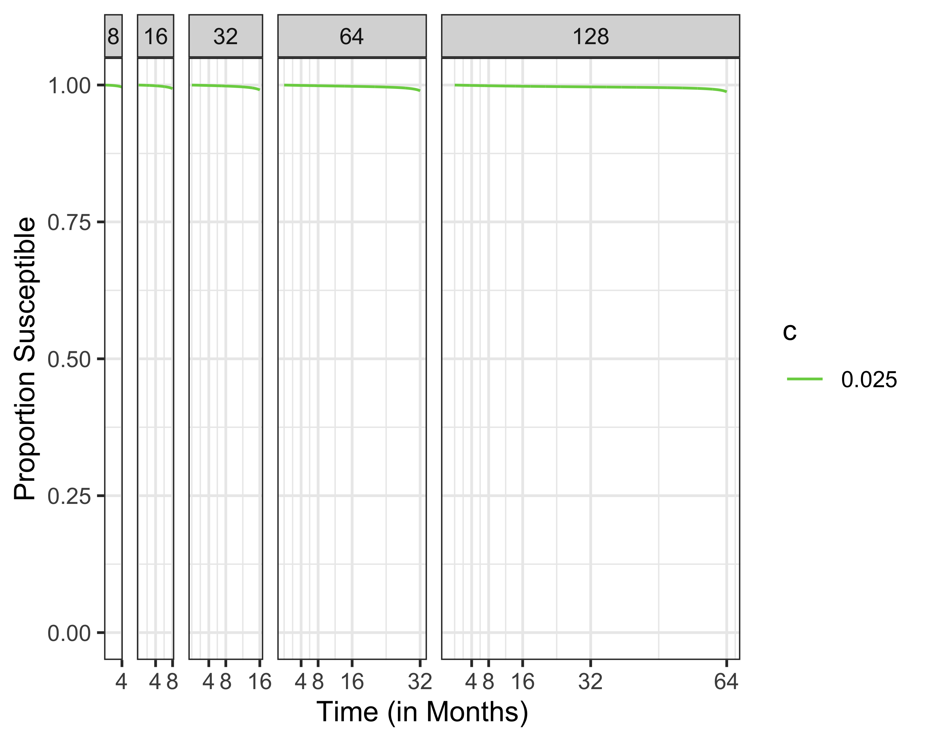
Susceptibles Different Time Horizons

Slide 30
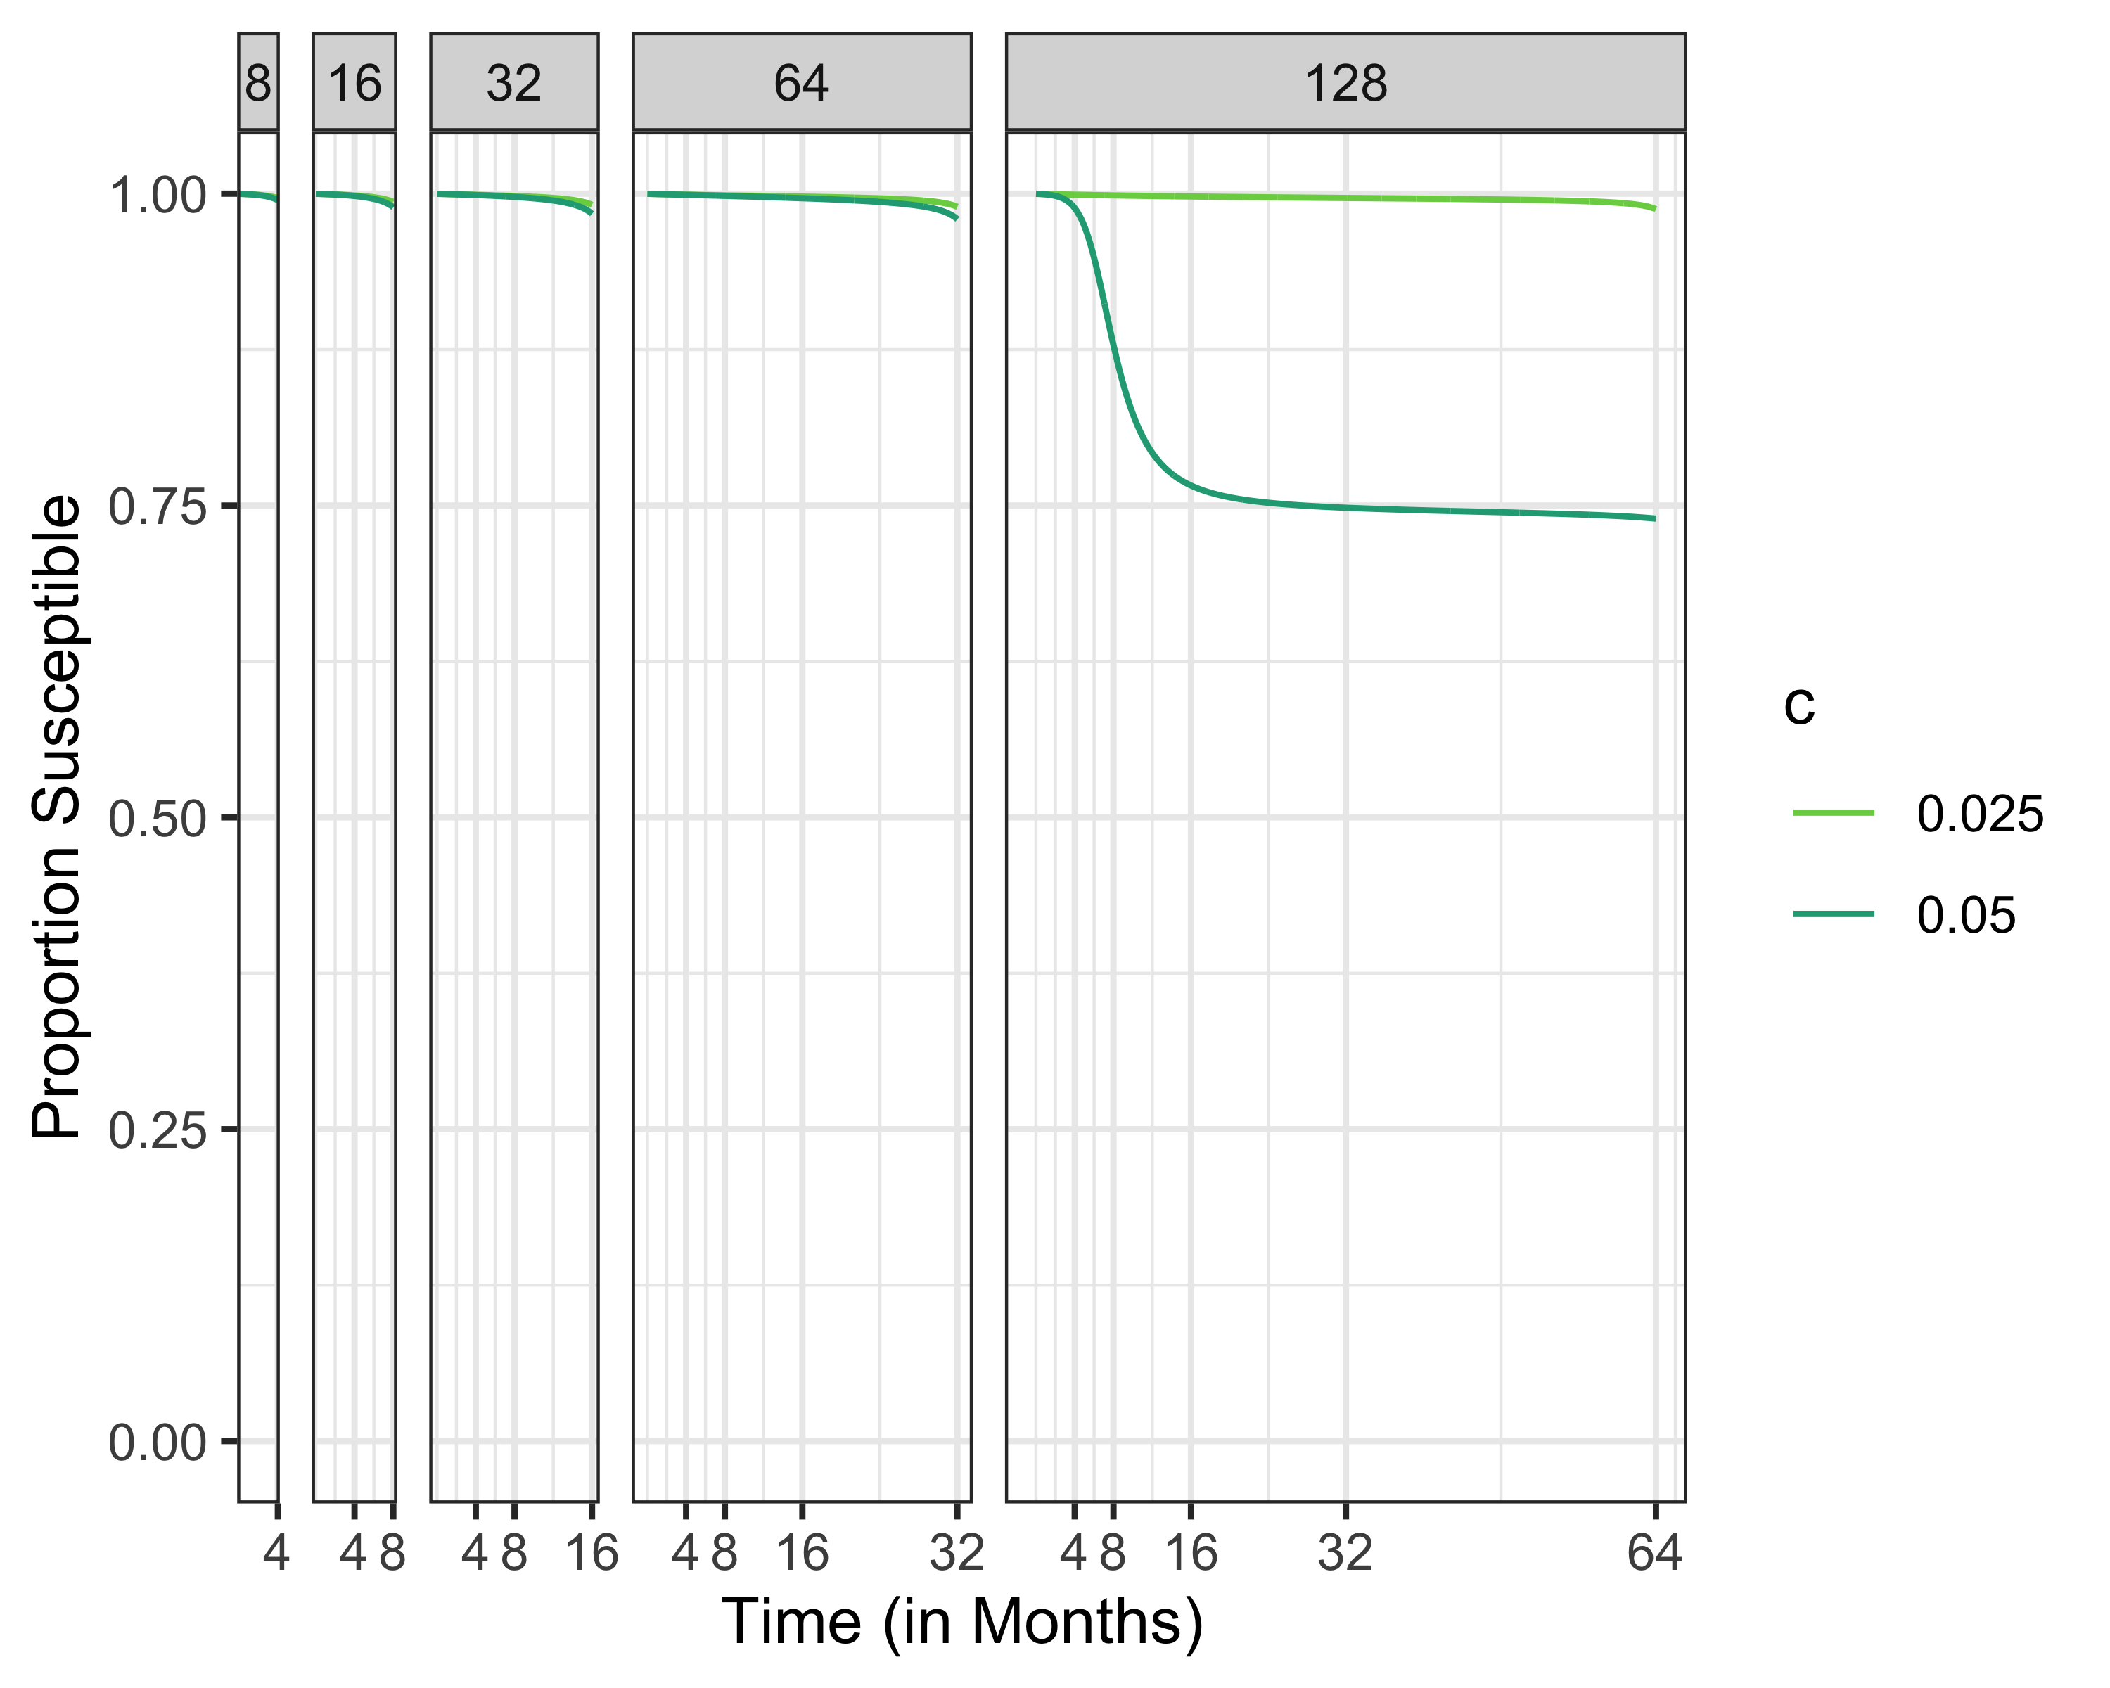
Susceptibles Different Time Horizons

Slide 31
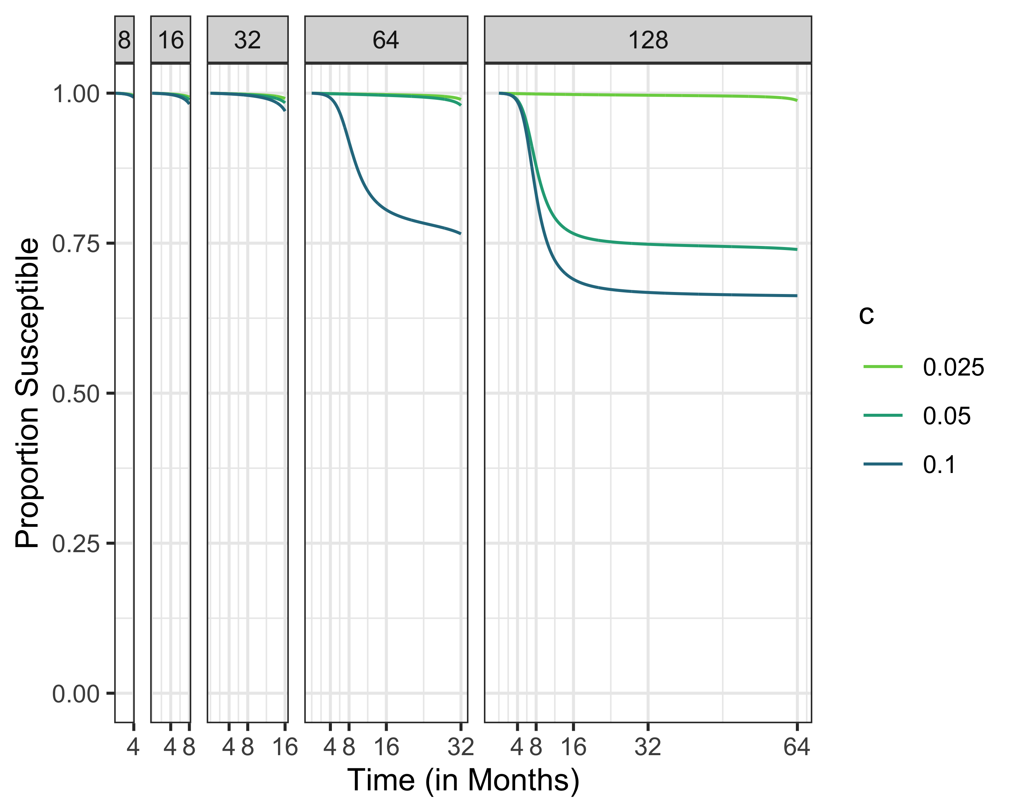
Susceptibles Different Time Horizons

Slide 32
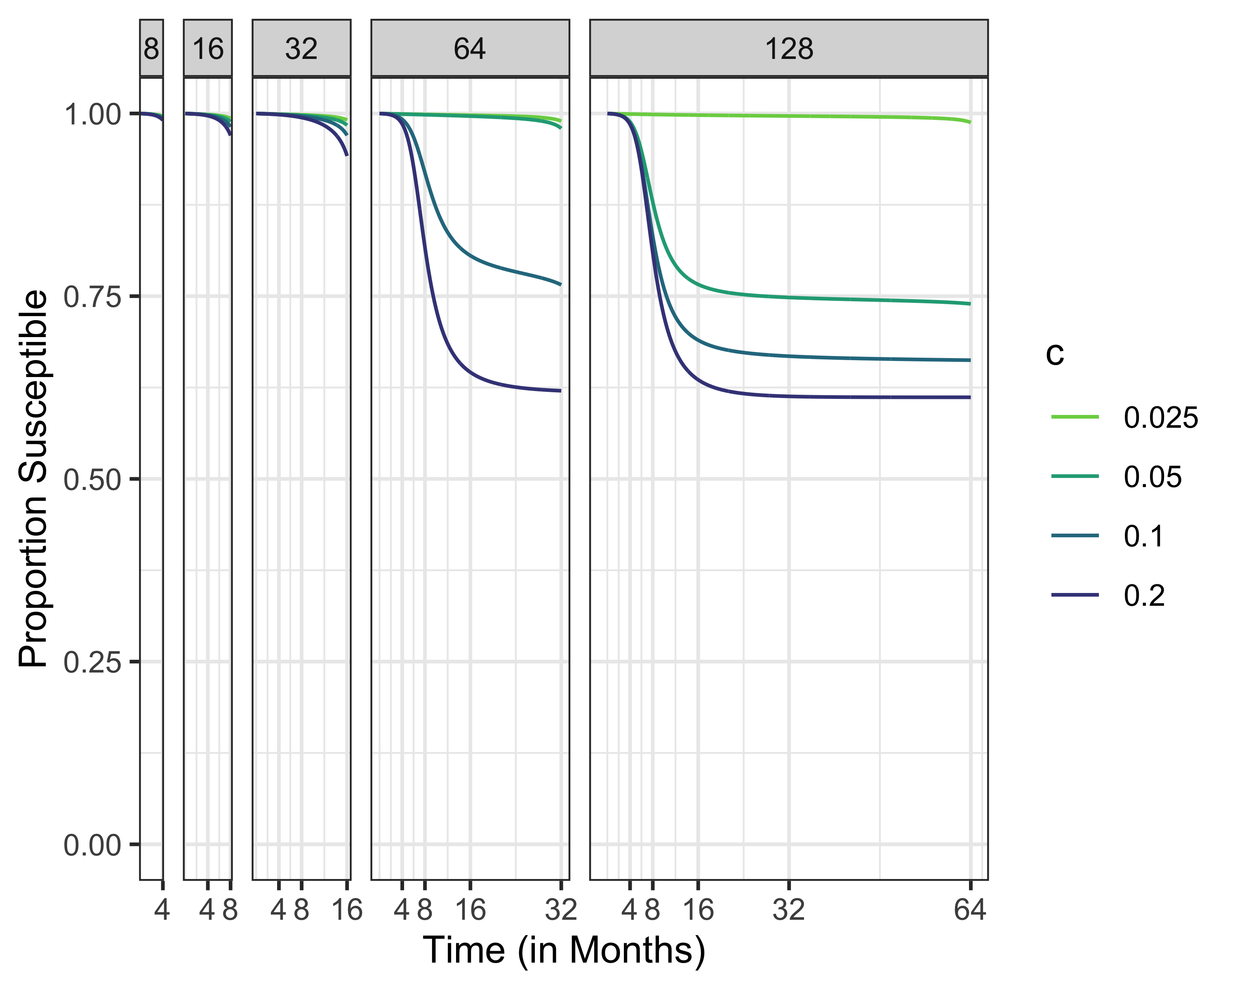
Susceptibles Different Time Horizons

Slide 33
Sinf1.5 <- multiroot.1D(f=f1.5,start = .5,nspec= 1)[["root"]] Sinf2.5 <- multiroot.1D(f=f2.5,start = .5,nspec= 1)[["root"]] Sinf5 <- multiroot.1D(f=f5,start = .5,nspec= 1)[["root"]] S1.5max <- 1/1.5 S2.5max <- 1/2.5 S5max <- 1/5

Slide 34
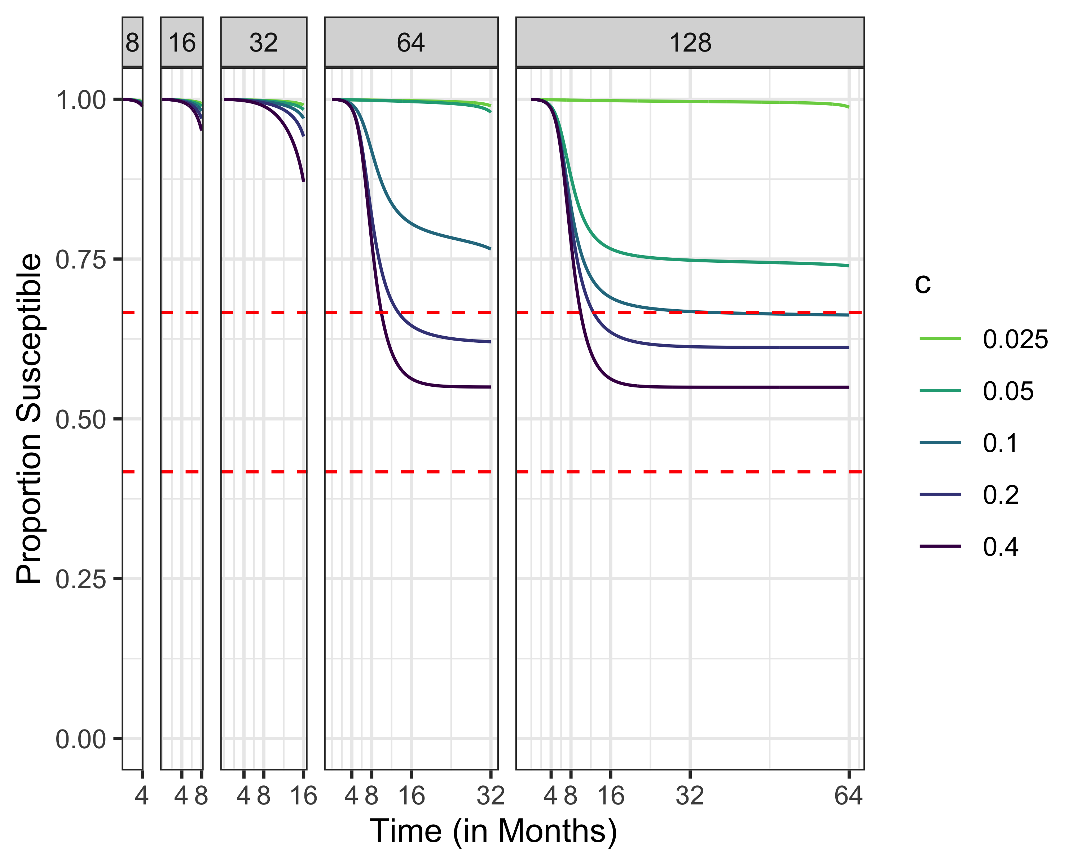
Susceptibles, R0 = 1.5

Slide 35
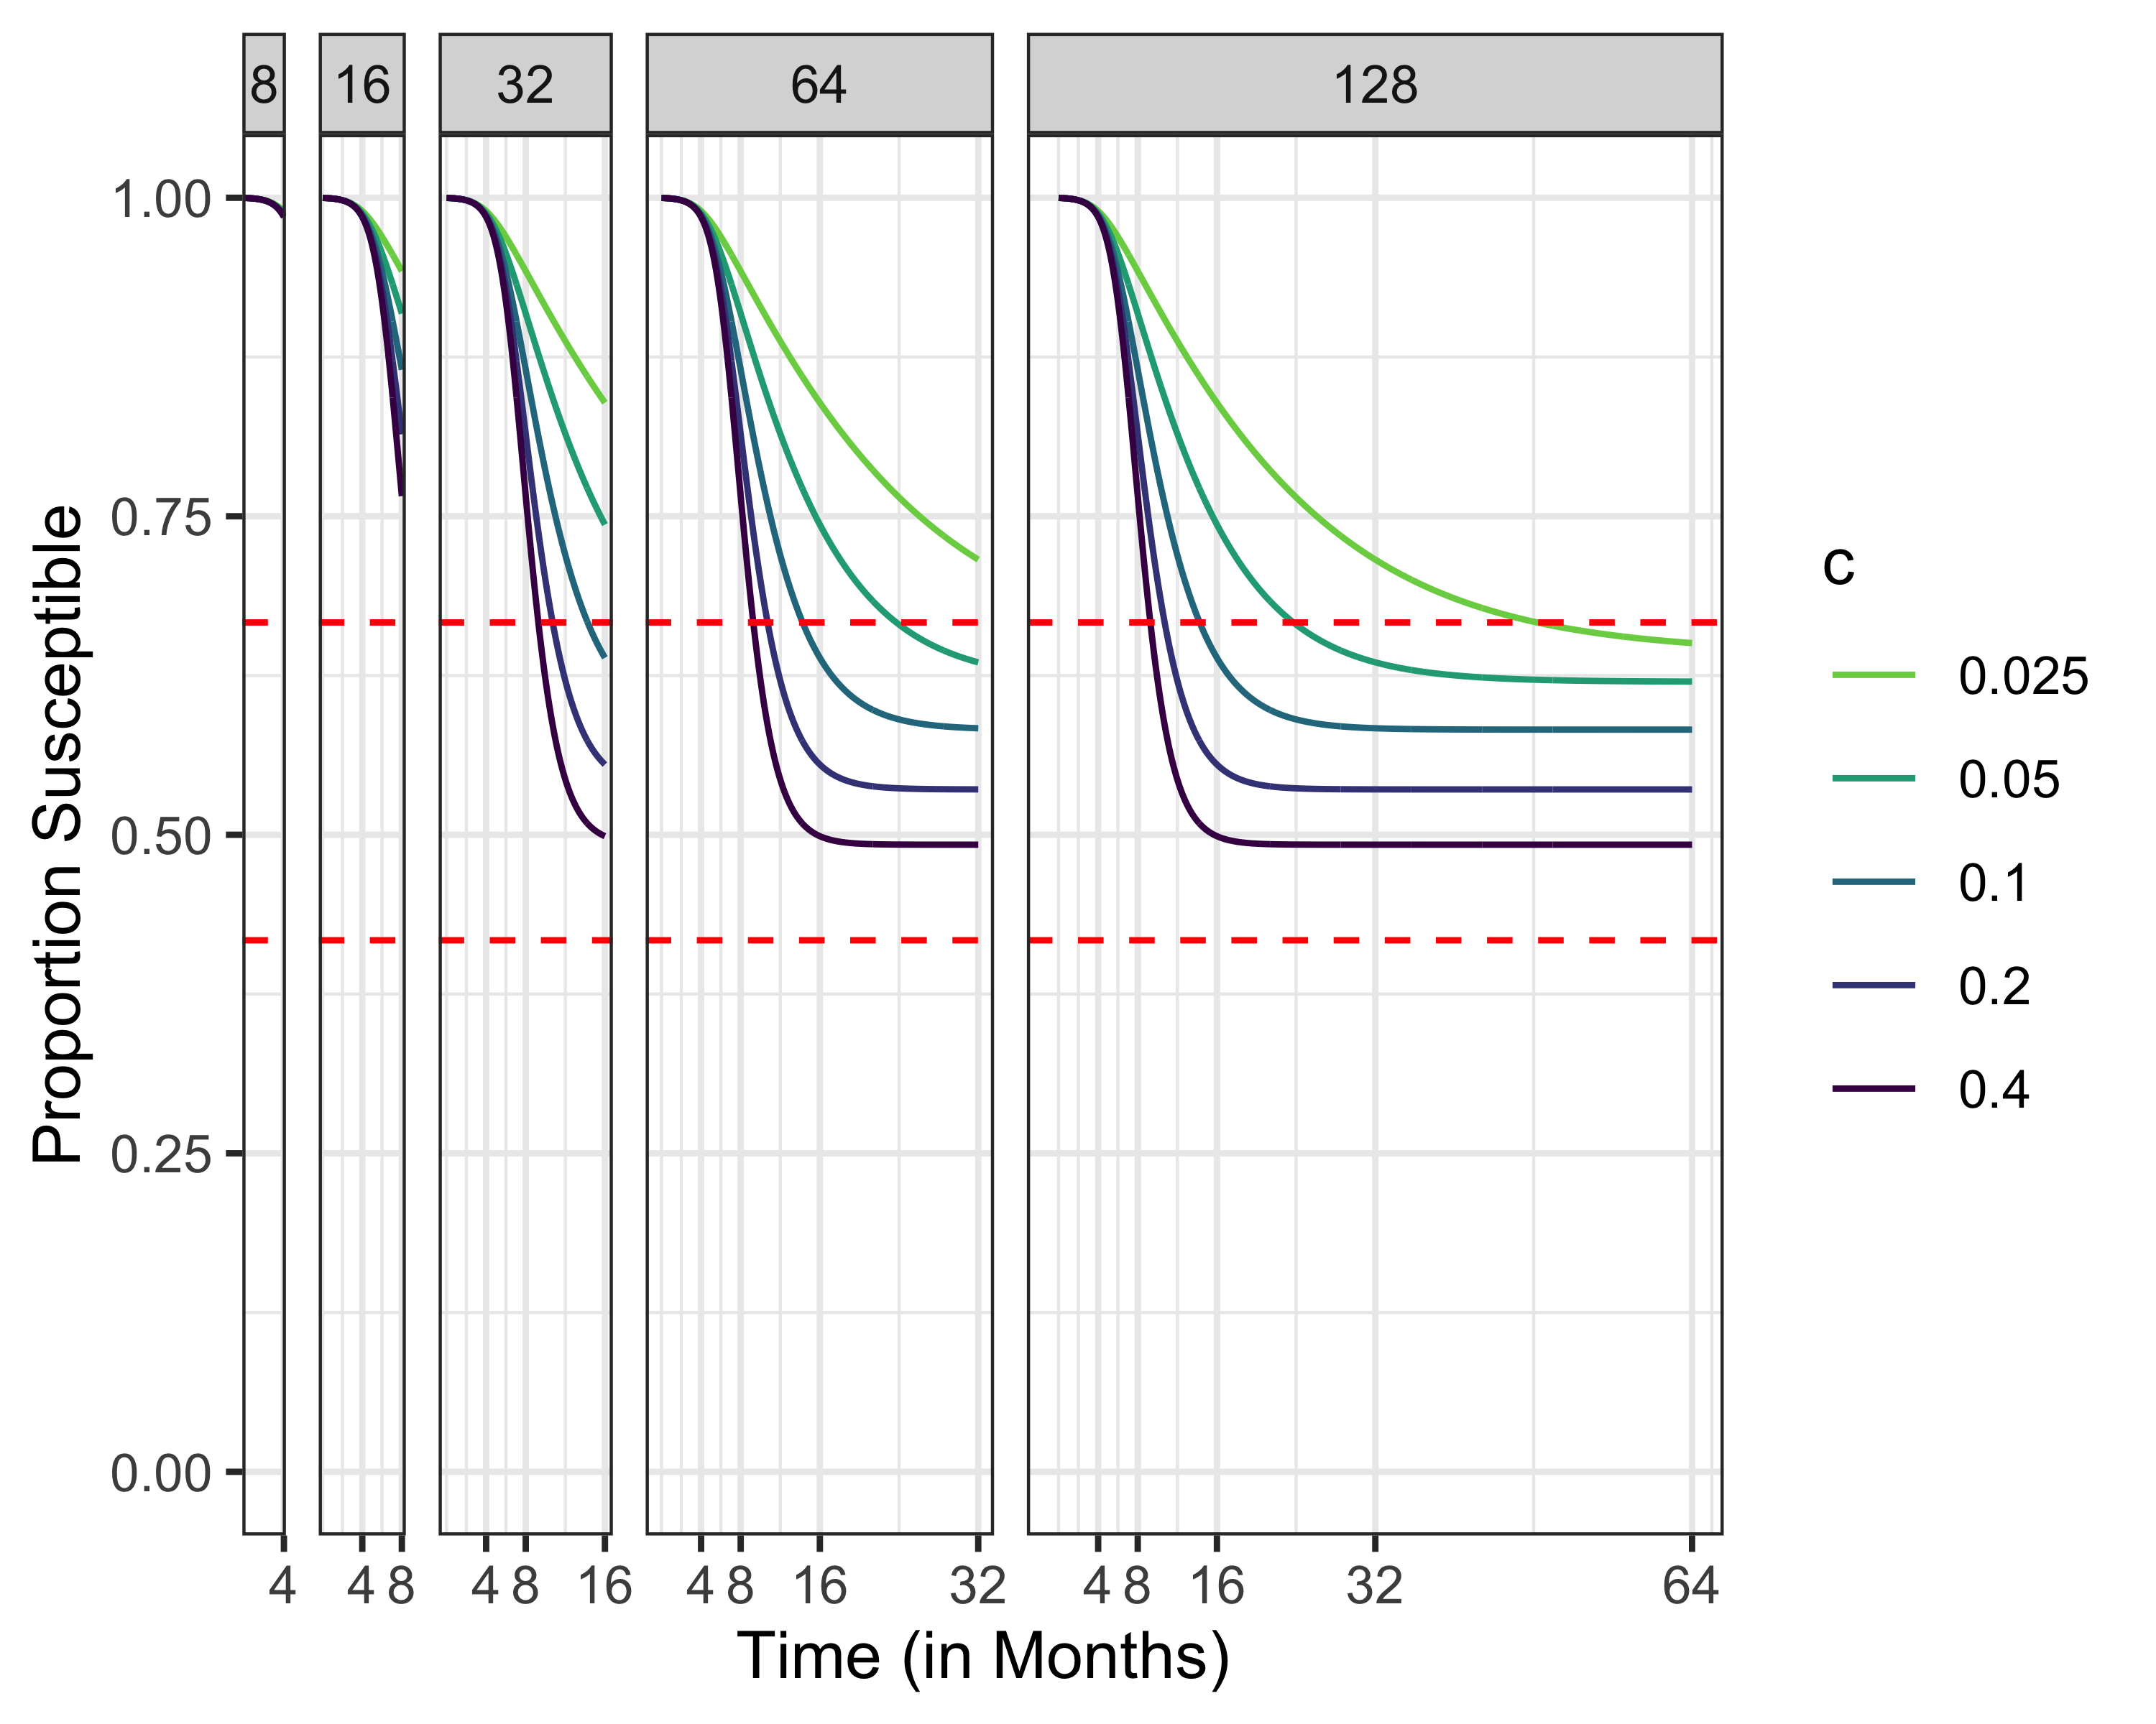

Slide 36
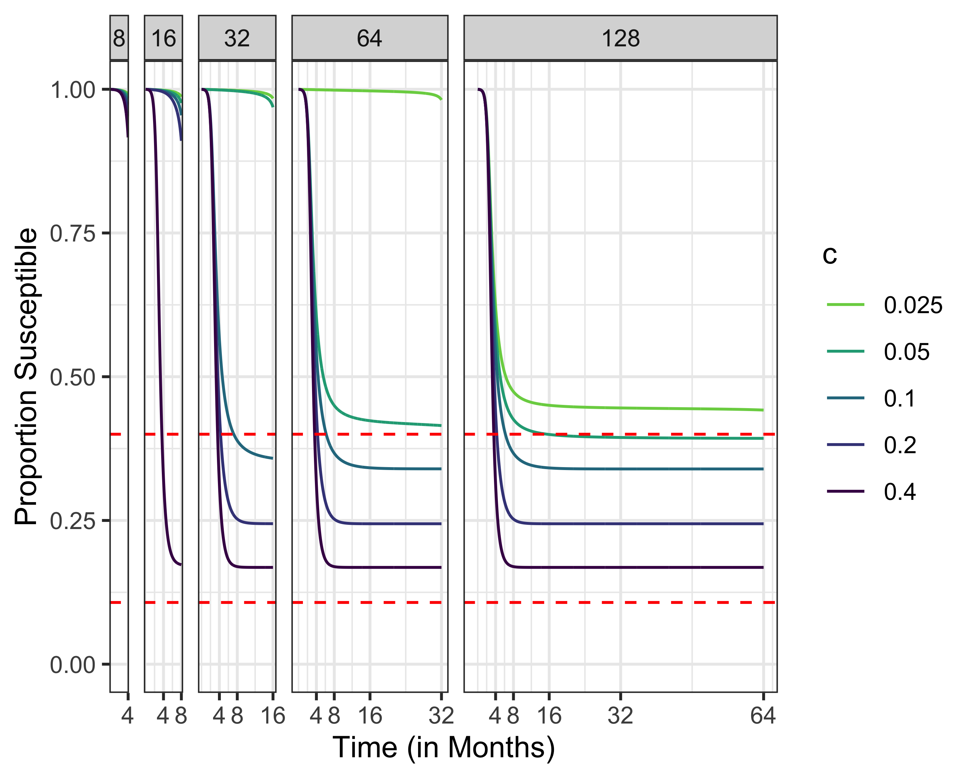
Susceptibles, R0 = 2.5

Slide 37
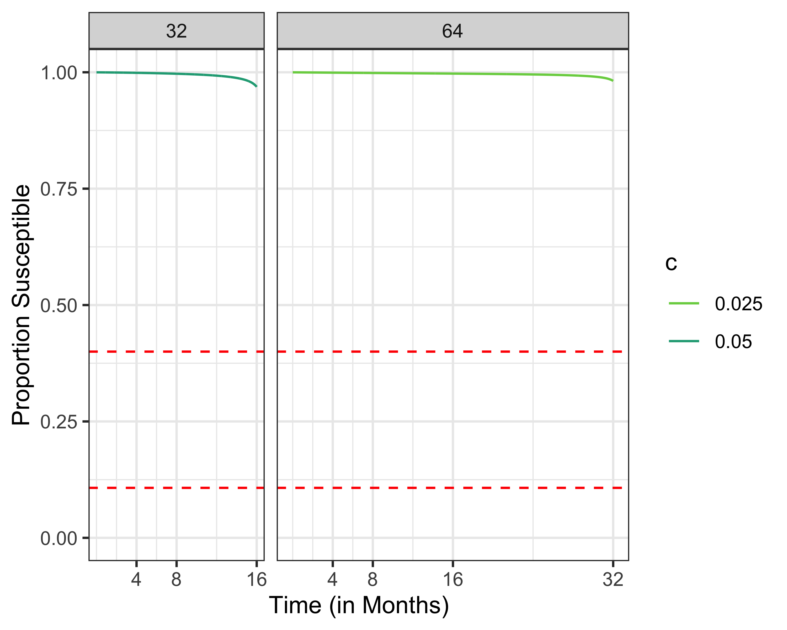
Susceptibles, R0 = 2.5

Slide 38
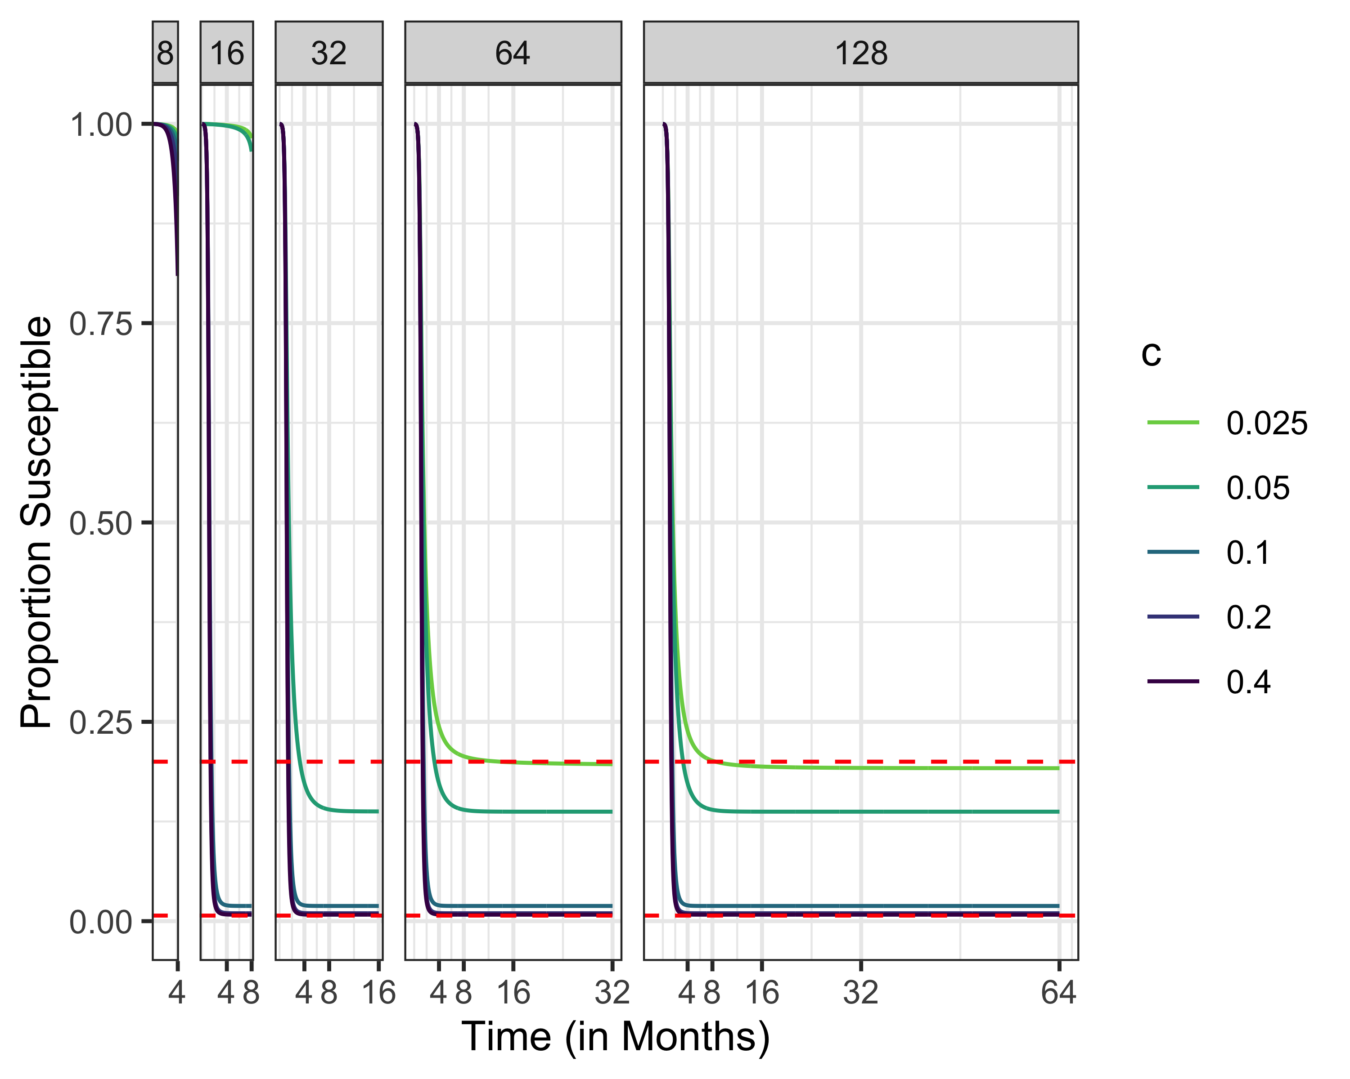
Susceptibles, R0 = 5

Slide 39
fR0 <- function(x,R0){exp(-R0*(1-x))-x} Sinf1.5 <- multiroot.1D(f=fR0,R0=1.5,start = .5,nspec= 1)[["root"]] Sinf3 <- multiroot.1D(f=fR0,R0=3,start = .5,nspec= 1)[["root"]] Sinf4.5 <- multiroot.1D(f=fR0,R0=4.5,start = .5,nspec= 1)[["root"]] Sinf6 <- multiroot.1D(f=fR0,R0=6,start = .5,nspec= 1)[["root"]] S1.5max <- 1/1.5 S3max <- 1/3 S4.5max <- 1/4.5 S6max <- 1/6 epi.size <- cbind(R0 = c(1.5,3,4.5,6),EpiInf = c(1-Sinf1.5,1-Sinf3,1-Sinf4.5,1-Sinf6),EpiMin = c(1-S1.5max,1-S3max,1-S4.5max,1-S6max)) all_cases = read.csv("INTERMEDIATE/sol.explore.all.csv") all_cases2 <- read.csv("INTERMEDIATE/parallel.output2.csv") all_cases3 <- read.csv("INTERMEDIATE/parallel.output3.csv") all_casesR03 <- read.csv("INTERMEDIATE/output-R03.csv") all_casesR045 <- read.csv("INTERMEDIATE/output-R045.csv") all_cases4 <- rbind(all_cases,all_cases2,all_cases3) all_cases4 <- subset(all_cases4,solved==TRUE&R0!=3&R0!=4.5) all_cases4 <- rbind(all_cases4,all_casesR03[,1:dim(all_cases4)[2]],all_casesR045[,1:dim(all_cases4)[2]]) #all_cases = all_cases %>% # dplyr::filter(R0 %in% c(1.5,3,4.5)) #data = read.csv("./Code/INTERMEDIATE/sol.explore-step11.csv") %>% # dplyr::select(tau, s, i, R_tau, Rt, case.id) #exp_design = read.csv("./Code/INTERMEDIATE/exper.design-step11.csv") %>% # dplyr::select(case.id, c, R0, i0, tFinal) # Selecting data fror the contour plot: ## Myopic myopic_data = read.csv("INTERMEDIATE/sol.explore-myopic20210730.csv") %>% dplyr::select(tau, s, i, R_tau, Rt, case.id) myopic_exp_design = read.csv("INTERMEDIATE/exper.design-round13.csv") %>% dplyr::select(case.id, c, R0, i0, tFinal) myopic_data <- left_join(myopic_data,myopic_exp_design) # Selecting data fror the contour plot: myopic_final_data = myopic_data %>% dplyr::filter(tFinal == tau&case.id>417) %>% mutate(EpiSize = 1-s) g <- myopic_final_data %>% ggplot(data = ., mapping = aes(x = tFinal, y = c, fill = EpiSize)) + geom_tile() + scale_fill_viridis_c()+ facet_wrap(facets = ~R0) g ggsave(filename = "FIGS/myopic_tile_plot.png",device = "png", plot = g, width = 3, height = 2.5, units = "in", scale = 2.5) g2 <- all_cases4 %>% dplyr::filter(tFinal == tau, case.id > 417) %>% mutate(EpiSize = 1-s) %>% ggplot(data = ., mapping = aes(x = tFinal, y = c, fill = EpiSize)) + geom_tile() + scale_fill_viridis_c()+ facet_grid(i0 ~R0) ggsave(filename = "FIGS/tile_plot.png",device = "png", plot = g2, width = 3, height = 2.5, units = "in", scale = 2.5) g3 <- all_cases4 %>% dplyr::filter(tFinal == tau, case.id > 417, R0==1.5, i0 == 1e-4) %>% mutate(EpiSize = 1-s) %>% ggplot(data = ., mapping = aes(x = tFinal, y = c, fill = EpiSize)) + geom_tile() + scale_fill_viridis_c() ggsave(filename = "tile_plot_1pt5.png",device = "png", plot = g3, width = 3, height = 2.5, units = "in", scale = 2.5) aux <- subset(all_cases4,R0 == 6 & c == 0.1 & i0 ==0.005) g3 <- aux %>% ggplot(data = .,mapping = aes(x = tau, y = s,group = tFinal,color = tFinal)) + scale_colour_viridis_c()+ geom_point() ggsave(filename = "problems.png",device = "png", plot = g3, width = 3, height = 2.5, units = "in", scale = 2.5) # Defining the Contour function loess_countour_plot = function(results, x_variable = "tFinal", y_variable = "c", dependent_variable = "EpiSize", facet_variable = "R0", facet_vector = c(2, 4), binwidth = 100, nudge_y = 0, nudge_x = 0, skip = 0) { if(is.null(facet_variable)) { selected_results = results[,c(x_variable, y_variable, dependent_variable)] names(selected_results) = c("x","y", "z") loess_model = loess(z ~ x + y, data = selected_results) } else { selected_results = results[,c(x_variable, y_variable, facet_variable, dependent_variable)] names(selected_results) = c("x","y","facet", "z") loess_model = loess(z ~ x + y + facet, data = selected_results) } x_vector= seq.default(from = min(selected_results$x), to = max(selected_results$x), length.out = 100) y_vector= seq.default(from = min(selected_results$y), to = max(selected_results$y), length.out = 100) if(is.null(facet_variable)) { meta_model_results <- expand.grid(x_vector, y_vector) names(meta_model_results) = c("x","y") mtrx3d = predict(loess_model, meta_model_results) # Transform data to long form mtrx.melt <- melt(mtrx3d, id.vars = c("x", "y"), measure.vars = "z") names(mtrx.melt) <- c("x", "y", "z") # Return data to numeric form mtrx.melt$x <- as.numeric(str_sub(mtrx.melt$x, str_locate(mtrx.melt$x, "=")[1,1] + 1)) mtrx.melt$y <- as.numeric(str_sub(mtrx.melt$y, str_locate(mtrx.melt$y, "=")[1,1] + 1)) } else { meta_model_results <- expand.grid(x_vector, y_vector, facet_vector) names(meta_model_results) = c("x","y","facet") mtrx3d = predict(loess_model, meta_model_results) # Transform data to long form mtrx.melt <- melt(mtrx3d, id.vars = c("x", "y", "facet"), measure.vars = "z") names(mtrx.melt) <- c("x", "y", "facet", "z") # Return data to numeric form mtrx.melt$x <- as.numeric(str_sub(mtrx.melt$x, str_locate(mtrx.melt$x, "=")[1,1] + 1)) mtrx.melt$y <- as.numeric(str_sub(mtrx.melt$y, str_locate(mtrx.melt$y, "=")[1,1] + 1)) mtrx.melt$facet <- as.numeric(str_sub(mtrx.melt$facet, str_locate(mtrx.melt$facet, "=")[1,1] + 1)) } # We should not find NAs in the mtrx.melt dataframe: if(any(is.na(mtrx.melt))){ # Found NAs in the mtrx.melt data.frame. Check inputs. browser() } ### Results from the metamodel: plot_function = function(data, facet_variable) { if(is.null(facet_variable)) { names(data) = c("x","y","z") } else { names(data) = c("x","y",facet_variable, "z") } plot <- ggplot(data, aes(x, y)) + geom_tile(aes(fill=z)) + ggplot2::geom_contour(aes(z = z), color = "black", binwidth = binwidth, size = 1) if(!is.null(facet_variable)) { plot = plot + facet_wrap(facets = facet_variable, labeller = label_both) } # computing breaks: bins = (max(data$z) - min(data$z))/binwidth breaks = pretty(x = data$z,n = bins) plot = plot + scale_fill_gradientn(colours=tim.colors(128), breaks = breaks) + # Adjusts Contour text positions metR::geom_text_contour(aes(z = z),show.legend = T,stroke.color = "white", binwidth = binwidth, skip = skip, nudge_y = nudge_y, nudge_x = nudge_x) + #hrbrthemes::theme_ipsum_ps(axis_title_just = "c") + ggpubr::theme_pubclean() + theme(legend.position="bottom") + theme(axis.title = element_text(face=1)) plot } mtrx.melt %>% plot_function(data = ., facet_variable = facet_variable) }

